Slide 1

FY 2013 General Child Abuse & Neglect Prevention Grant Program
APPLICATION WORKSHOP
Friday, January 20, 2012

Slide 2
Children’s Trust Fund Staff:
Kirk Schreiber, Executive Director
  573-751-5147 kirk.schreiber@oa.mo.gov
  Laura Malzner, Program Coordinator
  573-751-6511 laura.malzner@oa.mo.gov
Alicia Whitson, Office Manager
  573-751-5147 alicia.whitson@oa.mo.gov
  Paula Cunningham, Public Affairs Coordinator
  573-751-5147 paula.cunningham@oa.mo.gov
  CTF General Information
  573-751-5147 ctf@oa.mo.gov
  Website: www.ctf4kids.org

Slide 3
Program Overview

Slide 4
About CTF’s Contracting Authority
The Children’s Trust Fund (CTF) was established in 1983 by the Missouri General Assembly to insure efforts to prevent and alleviate the leading causes of child abuse and neglect. CTF, dedicated solely to support child abuse/neglect prevention projects throughout the state, is authorized to enter into contracts with public or private agencies, schools or qualified individuals to establish community-based educational, service, and family support programs focused on the prevention and/or alleviation of child abuse and neglect.

Slide 5
About CTF’s General CA/N Prevention Grant Program:
The General Prevention grant program
provides grants to community based organizations that work to prevent child abuse and neglect; inform and educate children, parents, professionals and the general public about child abuse and neglect; and/or promote public awareness of child abuse and neglect and educate others with how it can be prevented.

Slide 6
CTF General Prevention Funding:
Eligibility
To be eligible for CTF funding, applicants must:
Establish a child abuse/neglect prevention project serving residents of Missouri. Eligible projects must fit within the definitions of primary or secondary prevention;
Demonstrate a positive impact on variables highly correlated with the occurrence of child abuse and neglect and demonstrate that the project will help to prevent or reduce the occurrence of child abuse or neglect; and
Be able to demonstrate and measure the impact of the project with an objective, quantifiable evaluation component.

Slide 7
Eligible Applicants
CTF awards grants to public or private agencies, schools or qualified individuals.

Slide 8
Types of Prevention:
Primary: Also known as “Universal” programs, the target audience of Primary Prevention programs is the general population. Activities used in Primary Prevention are designed to stop maltreatment before it occurs.
Secondary: Secondary Prevention programs are aimed at families or communities who are high risk for child abuse and neglect. Services may be targeted for specific populations (for example teenage parents, parents of special needs children, single parents and low-income families, etc.).
Tertiary: Tertiary prevention programs are designed for families that have experienced child abuse and neglect. Services provided after the occurrence of child abuse and neglect are designed to prevent the recurrence of future abuse.

Slide 9
Who Can We Serve?
CTF funds may be used to provide services/programming within the state of Missouri.

Slide 10
Funding for FY 2013
Approximately
$400,000 is available statewide for new programs.
$747,473 is earmarked for continuation programs.

Slide 11
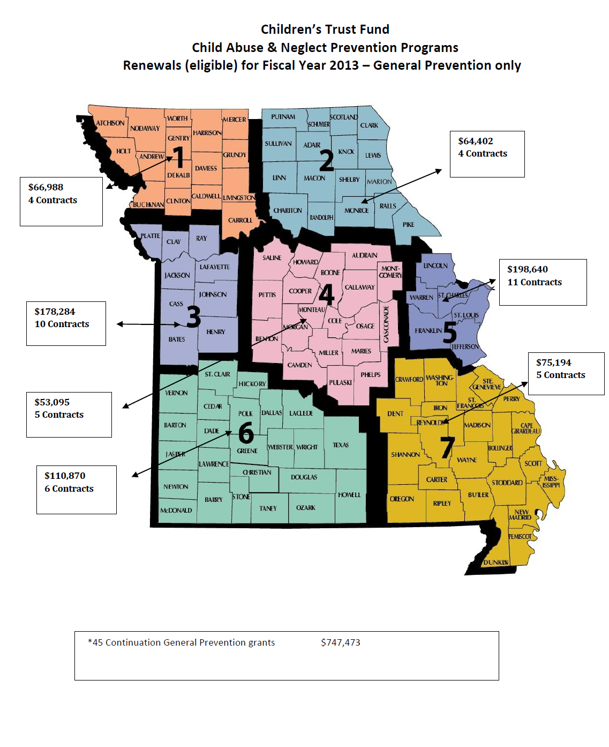

Slide 12
Funding Cycle
Assuming that adequate revenues are maintained, CTF will be able to offer second, third, fourth and fifth year funds to applicants through an annual renewal application process.
During the renewal process for second through fifth year funding, grantees will be expected to document progress in achieving their goals and objectives, and comply with administrative guidelines.

Slide 13
Matching Funds Requirements
Year 1: 0% local match (100% CTF)
Year 2: 0% local match (100% CTF)
Year 3: 25% local match (75% CTF)
Year 4: 50% local match (50% CTF)
Year 5: 75% local match (25% CTF)

Slide 14
CTF Funding Commitment
Example: $25,000 prevention grant = $87,500 in CTF funding over a 5 year period
$25,000 year 1
$25,000 year 2
$18,750 year 3
$12,500 year 4
$ 6,250 year 5
$87,500 total commitment from CTF
$37,500 in matching funds from grantee

Slide 15
CTF Funding Commitment
In awarding $400,000 in prevention funding, CTF is obligating $1,400,000 over a 5 year period.
$400,000 year 1 (100%)
$400,000 year 2 (100%)
$300,000 year 3 (75%)
$200,000 year 4 (50%)
$100,000 year 5 (25%)
$1,400,000 total commitment from CTF
$ 600,000 in matching funds from grantees

Slide 16
Funding Limits
CTF sets no limits on the minimum or maximum funding requested. However, please keep in mind that with only $400,000 available statewide, the range of individual awards will likely be between $25,000 and $40,000.

Slide 17
Eligible Budget Categories
Salaries and Wages
Fringe Benefits (capped at 28%)
Contractual Services
Space Costs
Consumable Supplies
Travel

Slide 18
Eligible Budget Categories, con’t
Communications (phone/cell)
Non-consumable Supplies
Program Related Expenses
Other Costs

Slide 19
Unallowable Costs
Debt
Capital Expenditures
Contingency or Reserve Fund
Contributions
Depreciation on assets
Expenses offset by other revenue sources (supplanting)
Fines or Penalties
Fundraising
Legal expenses
Lobbying expenses
Interest expense
Contract supplies
Moving/relocation costs
Organizing/Reorganizing costs
Taxes

Slide 20
Evidence-based Programming and
Effective Practices
Priority will be given to proposals that include the use of model (evidence-based/informed) programs, promising practices, and/or best practices when working with at-risk children and families.
Effective practices and methodology for working with such populations have been identified by federal, state, and national child advocacy organizations (page 20).
Notes:
In your application you will find several websites that are resources for identifying these types of programs.

Slide 21
Evidence-based Programming and
Effective Practices
Applicants must provide the following:
Proposals must include photocopied or printed information taken directly from the identified source of the model program, promising practice, and/or best practice that is being proposed.
http://www.childwelfare.gov/preventing/evaluation/ebp_registries.cfm

Slide 22
Types of Programs
(Examples of the types of programs CTF has/is funding)
Home Visitation services
Safe sleep/safe crib education
Crisis nursery services
School-based prevention education
Fatherhood support
Grandparent support
Parent Education (i.e. Nurturing Parents©, Conscious Discipline©)
Parent mutual/peer support (i.e. Circle of Parents©)
Shaken Baby Syndrome education programs
Mentoring
Strengthening Families (focused on the protective factors)

Slide 23
SF Protective Factors
Parental Resilience
Social Connections
Concrete Support in Times of Need
Knowledge of Parenting and Child Development
Social and Emotional Competence of Children
http://www.cssp.org/reform/strengthening-families
Attachment 1 in the application packet

Slide 24
Obtaining the General Prevention Application
The General Prevention Application can be found at www.ctf4kids.org
or
email laura.malzner@oa.mo.gov

Slide 25
About the Application
It is available in Word format.
Be sure to follow the outline in the application and include all of the information requested.
Separate each section with the headings provided to clearly identify all information.

Slide 26
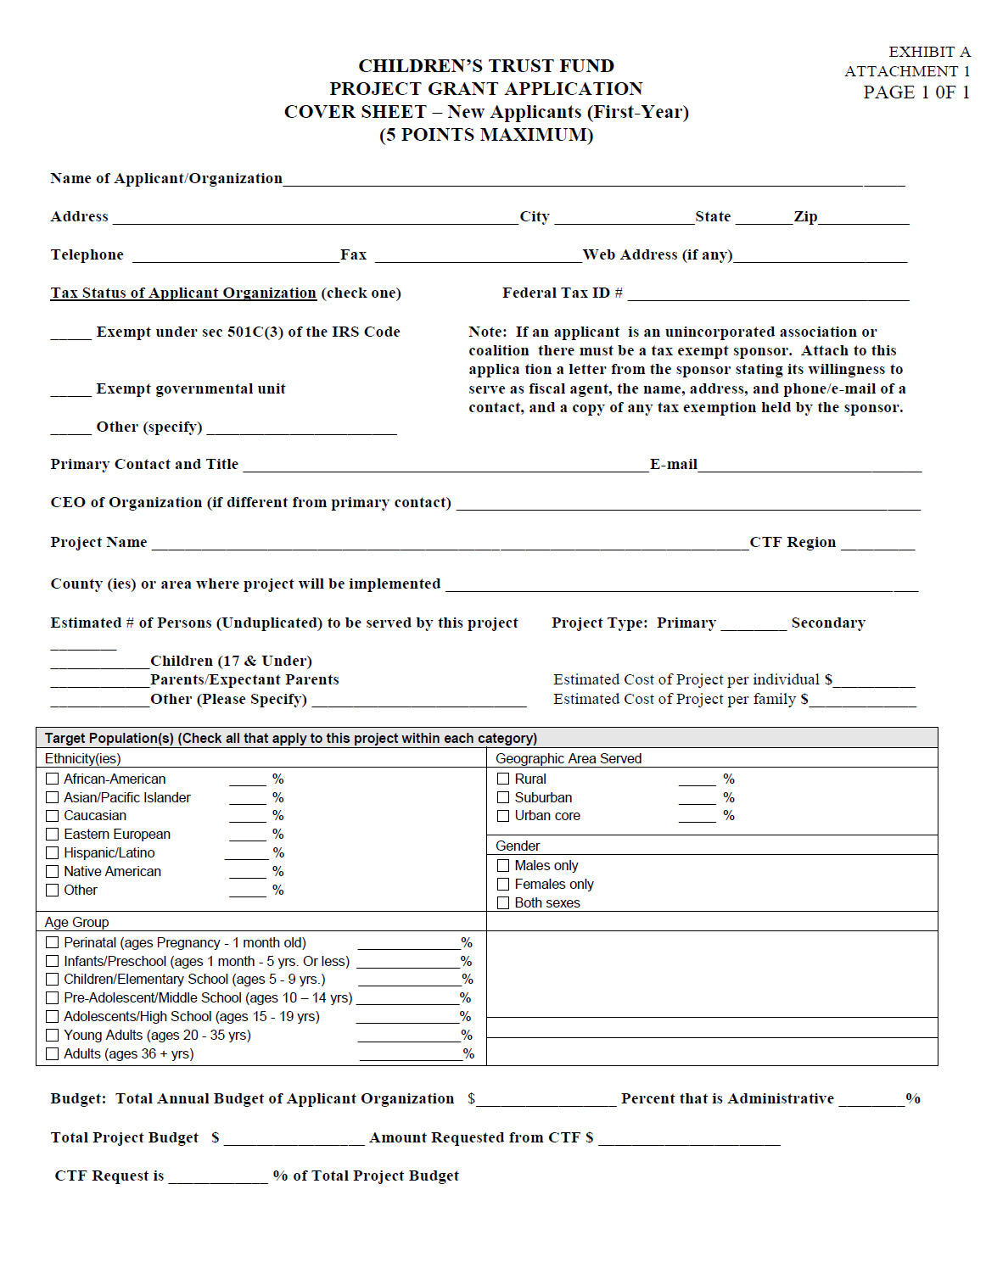

Slide 27
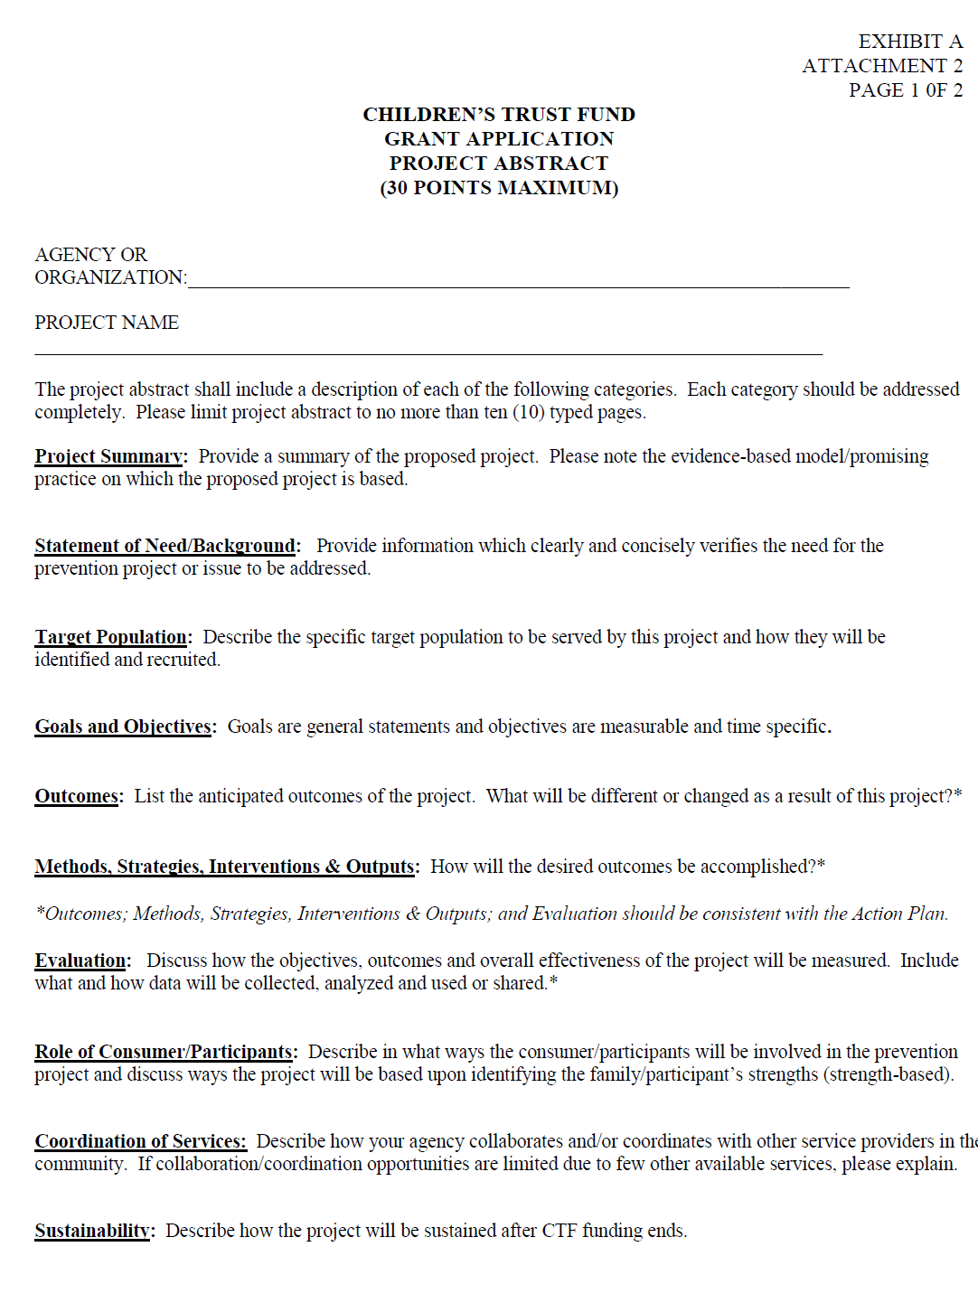

Slide 28
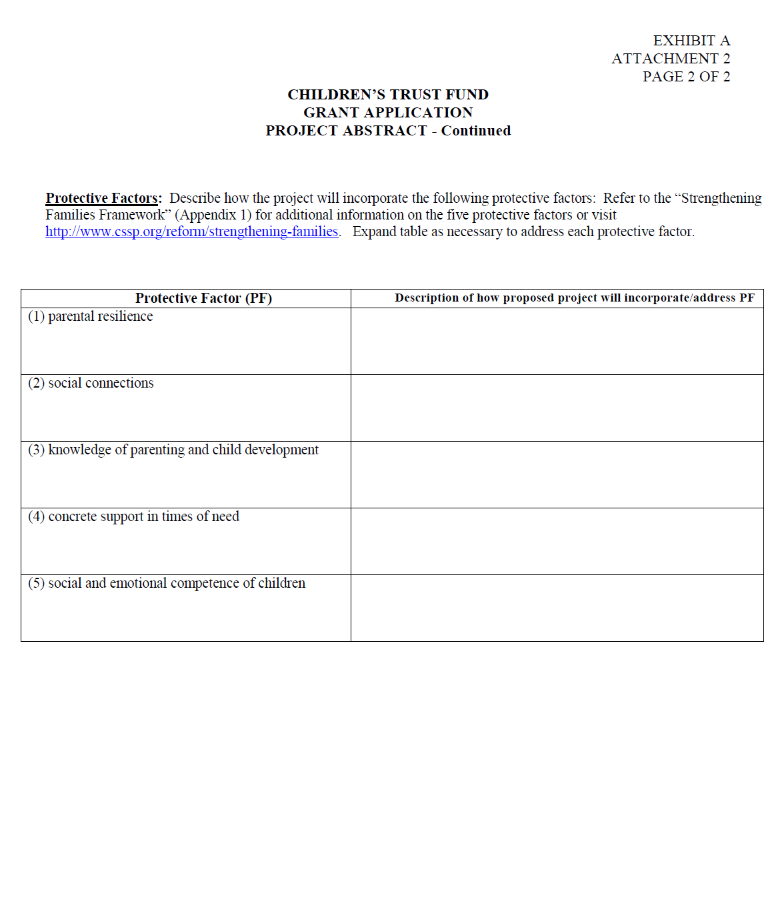

Slide 29
Project Abstract
  Use plain white paper
  Narrative must be typewritten
  Separate each section with headings
  Label all attachments
  Follow the requested outline and format

Slide 30
Project Abstract
Project Summary
Briefly describe the prevention project/proposal for which you are applying, and the evidence-based model/promising practice on which it is based.

Slide 31
Project Abstract
Statement of Need/Background
Provide information that supports the need for the prevention project in the proposed service area. It should also be reasonable in scope. In other words, the problem(s) is to be something that the applicant can do something about.

Slide 32
Project Abstract
Target Population:
Who will be served by the project? Include data about age, socioeconomic status, risk factors for abuse/neglect, and other factors that characterize the population to be served.
Where is this population located geographically?
How will the population be identified and recruited for the project?

Slide 33
Project Abstract
Goals & Objectives:
This section requires applicants to state the single, overall, defined goal(s) and objectives (activities) that will be implemented in order to support and achieve the goal(s). A goal is a broad-based statement that reflects an overall end result you are trying to attain. A goal must be clearly stated, realistic, and achievable. Objectives will be time-bound (ex: we will do X within 60 days).
Example of a Goal:
To partner with families to develop safe and effective parenting strategies.
Examples of Objectives/Supporting Activities:
Within the year, thirty (30) parents/caregivers will participate in training opportunities for the purpose of developing safe and effective parenting strategies.
Within the year, thirty (30) parents/caregivers will participate in training opportunities for the purpose of learning about early childhood development and appropriate expectations.
Sixty (60) families will voluntarily participate in XYZ evidence-based curriculum activities.
Notes:
Objectives should be time specific.

Slide 34
Project Abstract
Methods, Strategies & Outputs:
What are the components of the project and how will the project be implemented?
Describe the strategies, methods and interventions that will be used to achieve the objectives, and then ultimately the outcome.
Include outputs which are the specific activities, events, services, relationships and products generated (# of cribs distributed, SBS DVDs distributed, parents enrolled, volunteer mentors trained, parent classes offered, etc).

Slide 35
Project Abstract
Outcomes:
Outcomes should be behaviorally based (i.e. related to changes in knowledge, behavior, attitudes or conditions of the target population that will help prevent child abuse and neglect).
Outcomes must clearly relate to the stated problem or need and must be measurable.

Slide 36
Project Abstract
Evaluation:
The performance based measures must be identified in this section. Include a description of the data collection
and analysis procedures.
Be sure to tie these measures to the goals and objectives/activities for your proposed project.

Slide 37
Project Abstract
Role of Consumers/Participants:
Describe how the consumer/participants will be involved in the prevention project and discuss ways the project will identify the family/participant’s strengths (strength-based).

Slide 38
Project Abstract
Coordination of Services
Describe how your agency or organization works with other service providers in the community to maximize resources.

Slide 39
Project Abstract
Program Sustainability
Applicants must explain what steps will be taken to sustain this program after CTF funding is no longer available.

Slide 40
Project Abstract
Protective Factors:
Please describe how the project will integrate the following protective factors:
parental resilience,
social connections,
knowledge of parenting and child development,
concrete support in times of need, and
social and emotional competence of children.
Please refer to the “strengthening families framework” (Attachment 1) for additional information on the five protective factors.

Slide 41
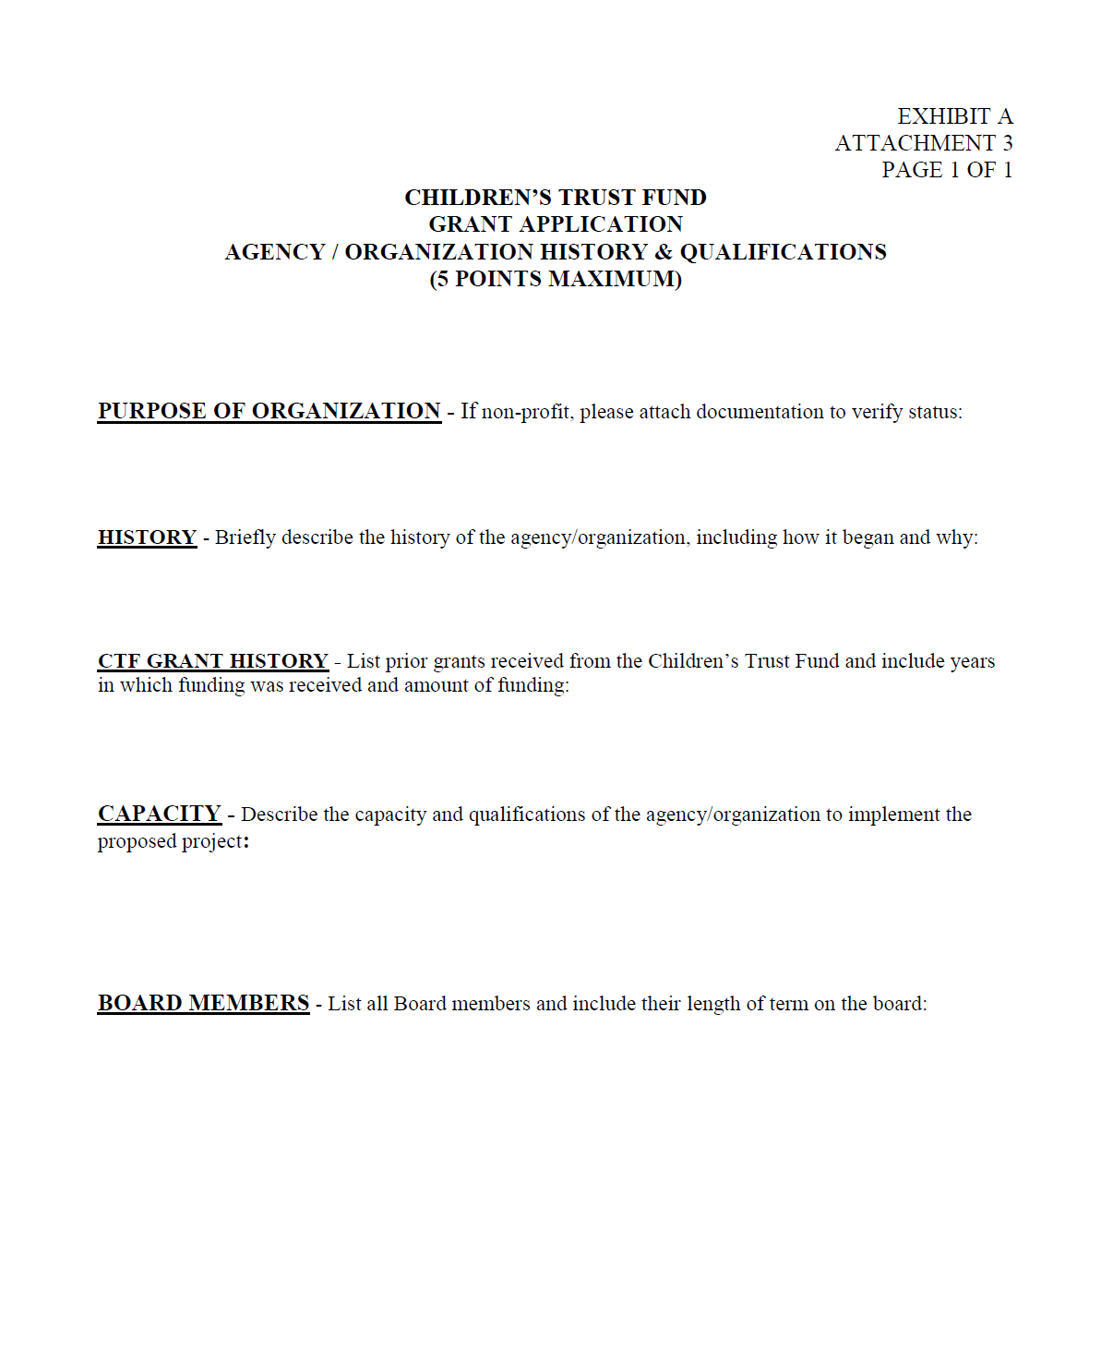

Slide 42
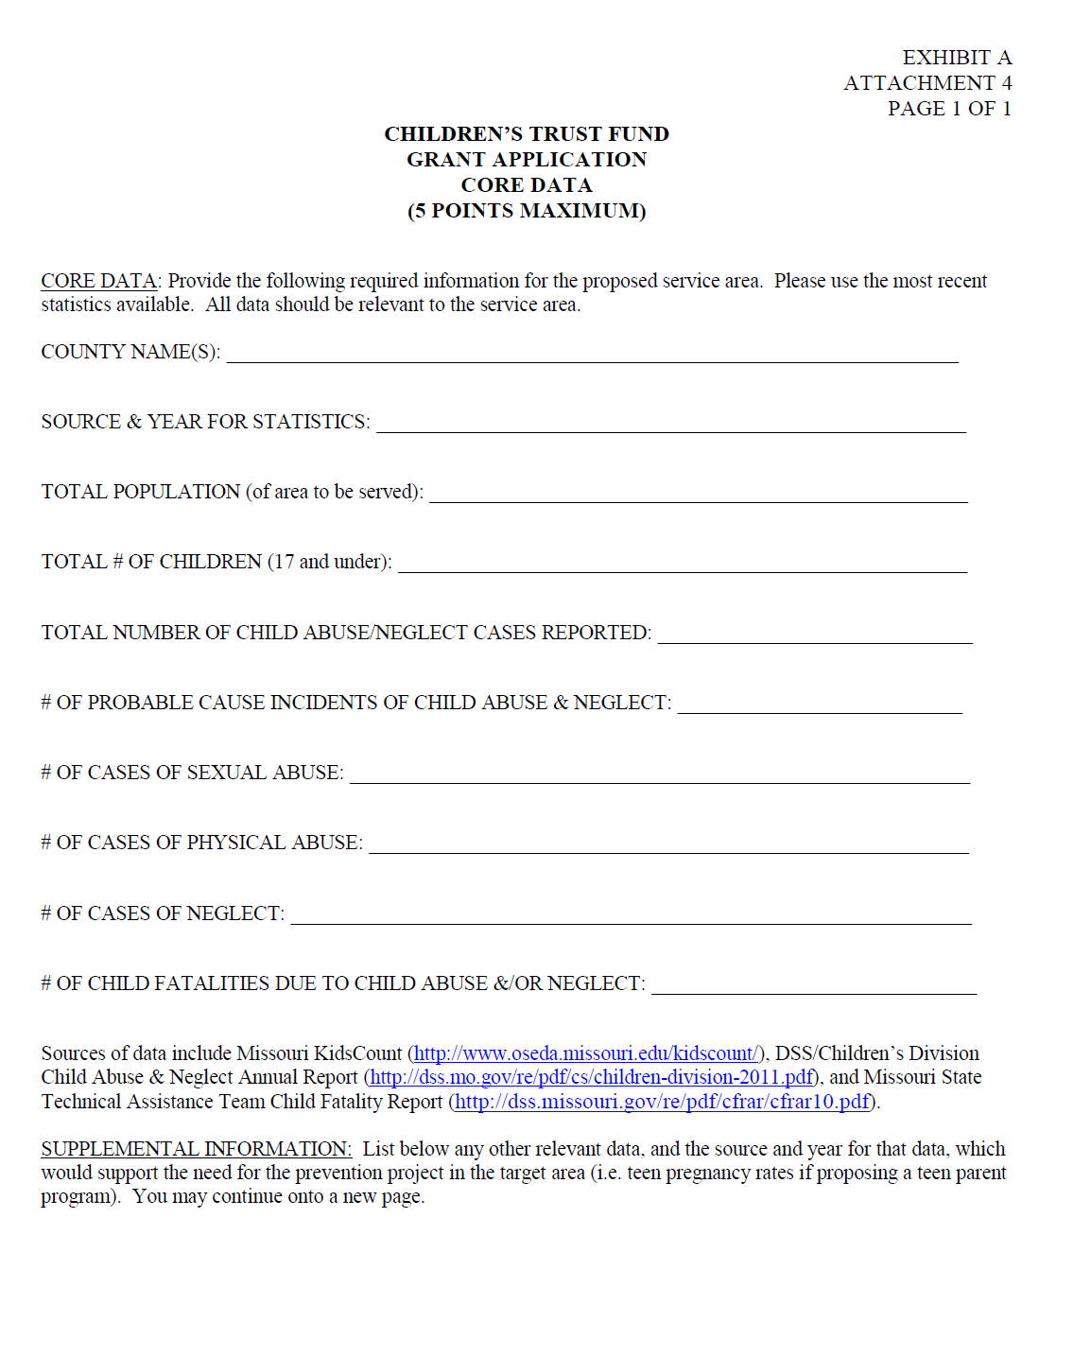

Slide 43
Data Sources
KidsCount Data Book:
http://www.oseda.missouri.edu/kidscount/
DSS/Children’s Division Child Abuse & Neglect Annual Report
http://dss.mo.gov/re/pdf/cs/children-division-2011.pdf
Missouri Child Fatality Review Program Annual Report
http://dss.missouri.gov/re/pdf/cfrar/cfrar10.pdf

Slide 44
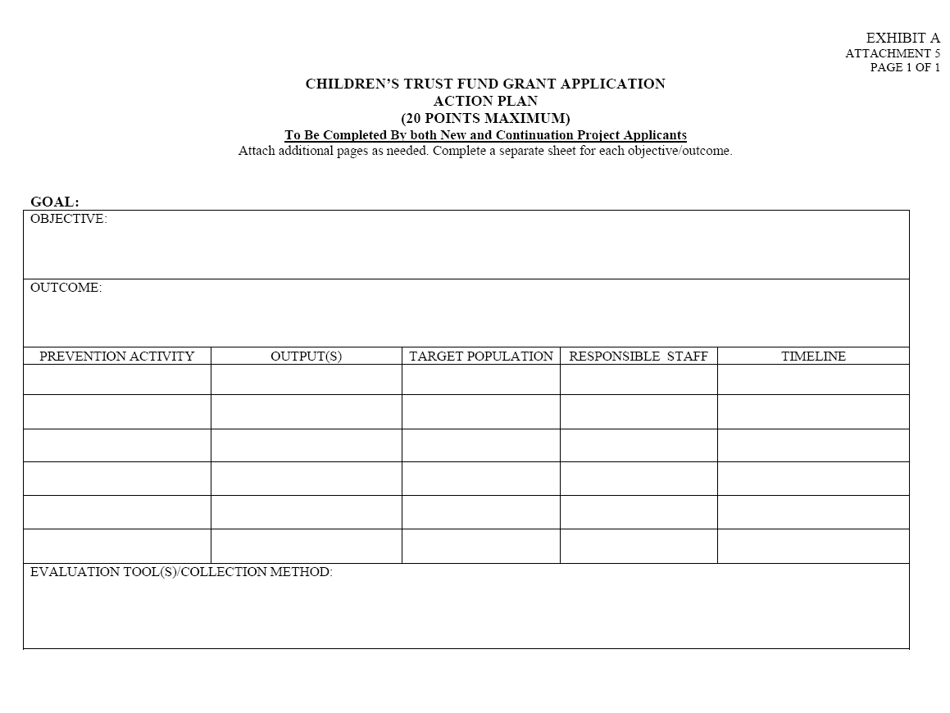

Slide 45
Action Plan
The information required in your Action Plan must agree with the information outlined in the Project Abstract.
Suggestion: Some folks find it helpful to work through the Action Plan worksheet(s) prior to working with the related components within the Abstract.

Slide 46
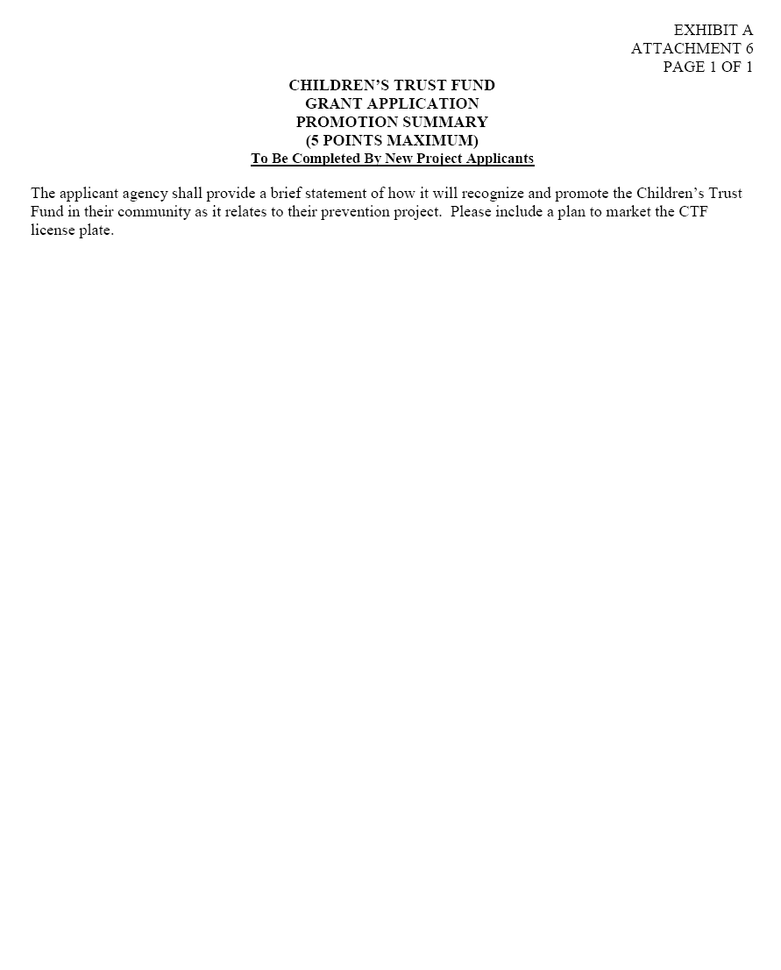

Slide 47
Budget Forms

Slide 48
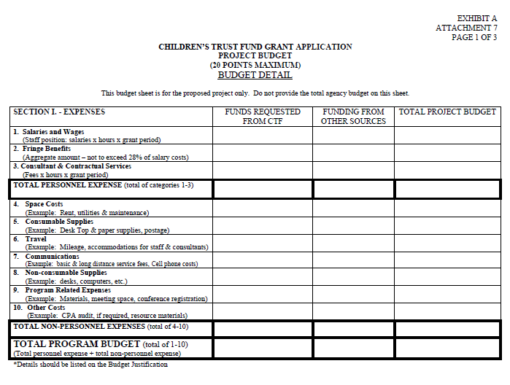

Slide 49
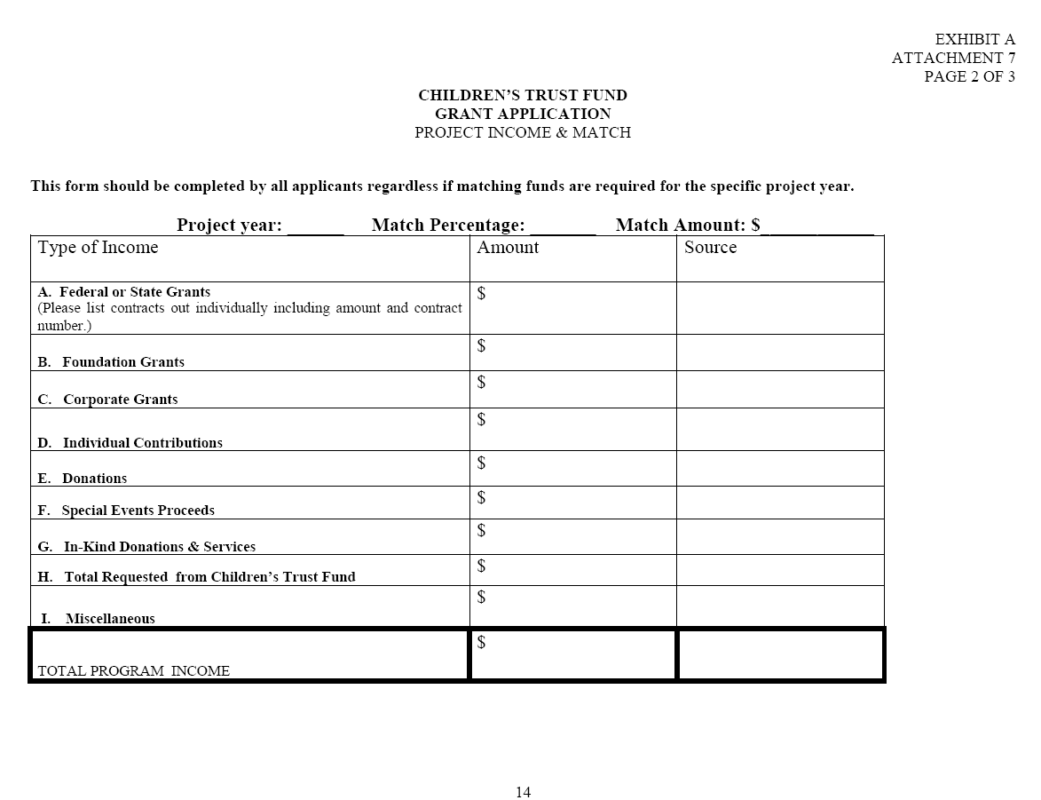

Slide 50
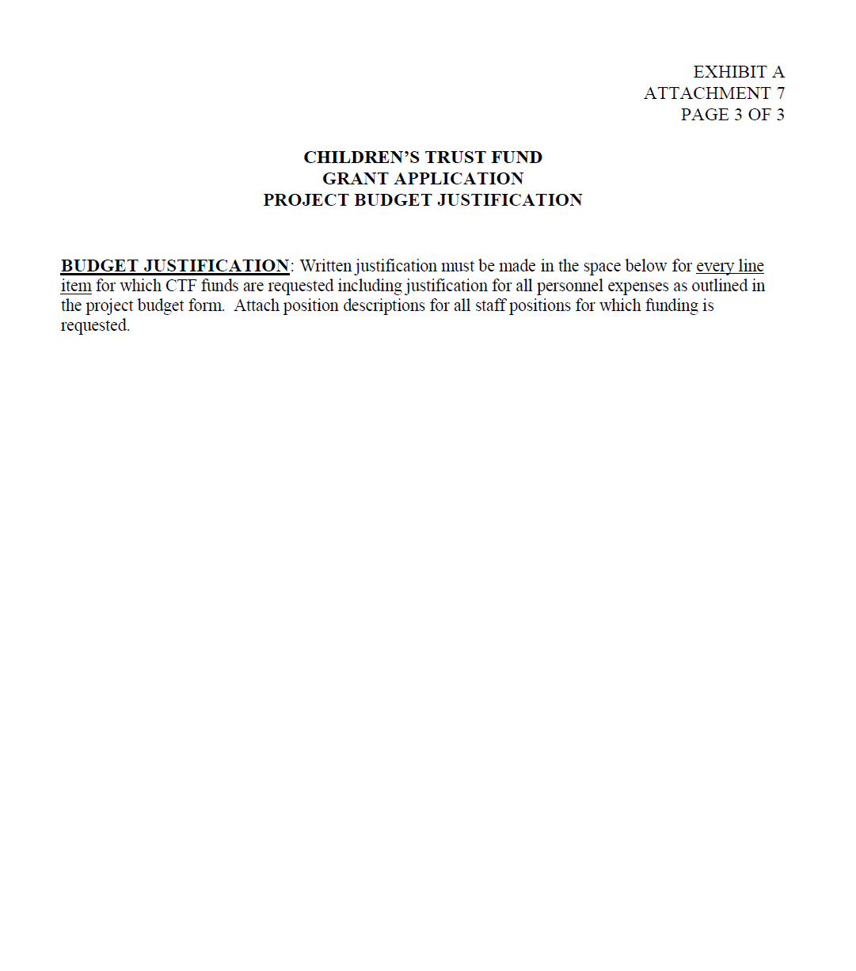

Slide 51
Budget Justification
Justify the need for each item listed in the budget for which CTF grant funds will be used. Be sure to justify each individual budget line item and provide a clear explanation of the need and purpose of each item. An explanation of each budget item must be included for consideration of funding.

Slide 52
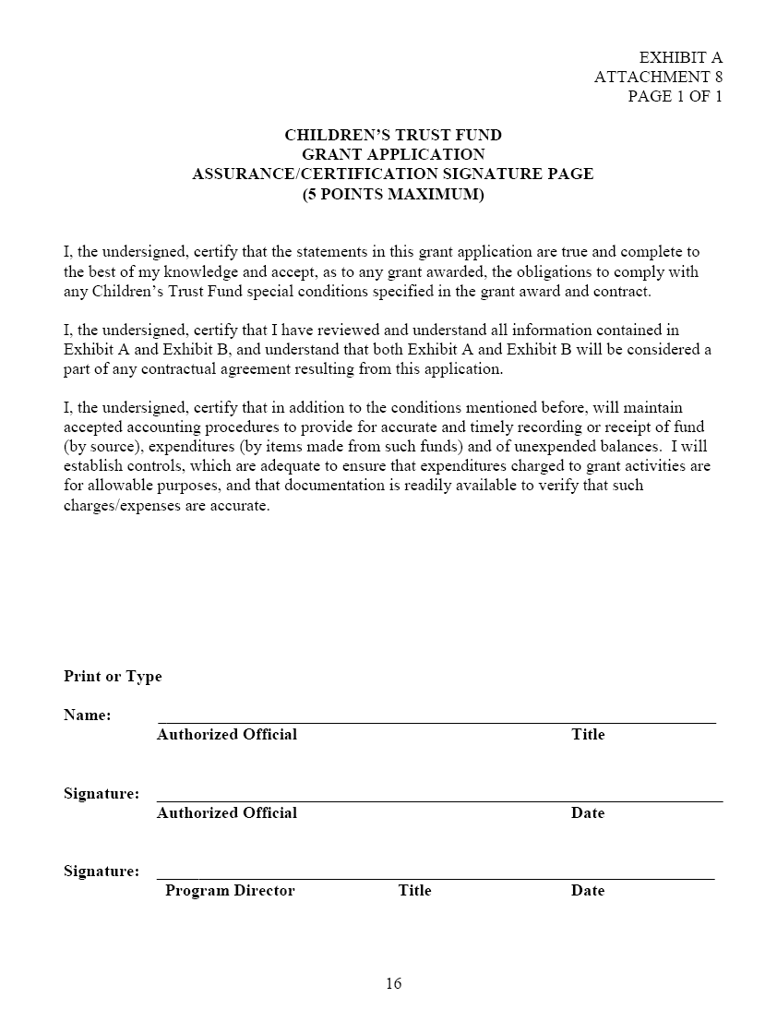

Slide 53
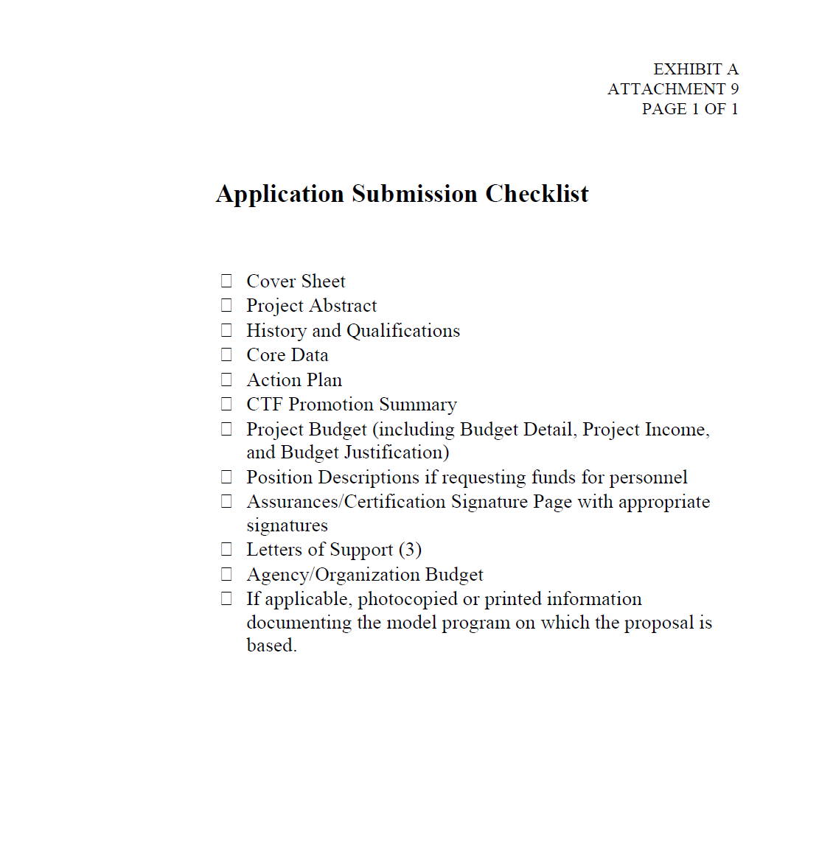

Slide 54
Additional Supporting Documentation

Slide 55
Additional Supporting Documentation
Evidenced-based Program Source Information
Applicants must provide a photocopied or printed description of the model program upon which the proposal is based.
The description must:
Identify which federal agency or other institution has evaluated the model.
Provide a brief overview of the program which includes an explanation of the program’s activities, target population, and success rate.

Slide 56
Additional Supporting Documentation
Other Documentation
If funding is requested for personnel, applicants must include copies of job descriptions for each proposed staff position at the time of application.
If funding is requested for contractual services, applicants must include a copy of the proposed contract agreement(s) for each service and a resume or curriculum vitae for the proposed contractor, if known, at the time of application.

Slide 57
Additional Supporting Documentation
Letters of Support – 5 points
The applicant may include three (3) letters of support. Letters of support must be current and cannot be from a proposed contractor or individual currently employed with the applicant agency.
Letters of support should be obtained from individuals familiar with the applicant and their history of providing quality services similar to those proposed. Letters that arrive separately from their corresponding application will not be accepted.

Slide 58
Additional Supporting Documentation
Financial and Organizational Information
  Current Copy of 501(c)(3) certification (if applicable)
  Organization/Agency Budget

Slide 59
Application Submission Instructions

Slide 60
When Submitting the Application…
  Mark the “ORIGINAL” application in the upper right-hand corner of the Cover Sheet.
  Applicants MUST use the forms provided by the Children’s Trust Fund.
  Include any statistics, data, and highlights of your project within the abstract/core data form where it best applies. It is not necessary to attach appendices of such information.
  All requested signatures in the application must be original. Stamped or faxed signatures will not be accepted.
  All applications must be signed by the proper individuals. Failure to secure proper signatures could result in an invalid application.

Slide 61
Application Due Date
  Applications must be postmarked or delivered by :
  March 12, 2012
  It is strongly recommended that applicants use a traceable shipping service that guarantees a delivery date to ensure that applications arrive timely.
  Applicants will not be contacted if an item is missing from the application, or if a component is technically incorrect.

Slide 62
Submission Instructions
One (1) original application and three (3) copies, for a total of four (4), must be submitted.
Applications must be stapled or clipped together in the upper left hand corner.
Do not place applications in folders.

Slide 63
Applications may be mailed or delivered to:
Children’s Trust Fund
Truman State Office Building, Room 860
301 W. High Street
Jefferson City, MO 65101
or
Children’s Trust Fund
P.O. Box 1641
Jefferson City, MO 65102
FAXED OR EMAILED APPLICATIONS WILL NOT BE ACCEPTED

Slide 64
Application Review and Award Process

Slide 65
Application Review and Award Process
The Children’s Trust Fund will use a three-part process for reviewing 2013 General Prevention applications:
Applications will be distributed to a review panel for review.
Review outcomes will be discussed with the CTF Board of Directors’ Program Committee and final recommendations formulated.
Final recommendations presented for full Board consideration on June 6, 2012.

Slide 66
Review Panel Scoring
General Prevention review panelists will use scoring guides for
evaluating applications. Listed below is a description of point
values assigned to the 2012 General Prevention Application.
1st Year Application Point Values
Cover Sheet……………………………………. 5 pts.
Project Abstract……….……………………….. 30 pts.
Agency/Organization History/Qualifications…. 5 pts.
Core Data……………………………………… 5 pts.
Action Plan…………………………………….. 20 pts.
Promotion Summary.…………………………... 5 pts.
Project Budget
Project Income & Match
Budget Justification…………………………… 20 pts.
Assurance/Certification Signature Page………… 5 pts.
Letters of Support (3)…………………………… 5 pts.

Slide 67
Award Decision Process
The Program Committee’s recommendations for funding will be presented to the CTF Board of Directors for final approval.
Notice of Awards will be mailed no later than June 7, 2012.

Slide 68
Contractual Agreement and Contract Period
If approved, an Award of Contract will serve as the contractual agreement between CTF and the applicant.
The contract period for approved projects is:
July 1, 2012
through
June 30, 2013

Slide 69
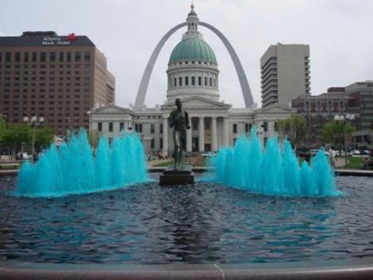
Questions?
Thank you!

