Slide 1
Dr. David Schramm Assistant Professor, Extension Specialist Dept. Human Development and Family Studies University of Missouri schrammdg@missouri.edu
Notes:
My background research

Slide 2
Presentation Overview
Provide an overview of the Healthy Relationship and Marriage Education Training (HRMET) project
Describe the research related to healthy couples – healthy children
Present results from HRMET trainings

Slide 3
Project Overview
National project (HRMET) to develop and deliver relationship and marriage education (RME) training to Child Welfare Professionals.
Have you worked with families and wished you had more information that might help them with relationship decisions?

Slide 4
Who We Are

Slide 5
Overarching Goals of HRMET
Share RME skills and resources as a way to support child welfare professionals in building protective factors in families, which may help prevent future child welfare involvement.
Improve the safety, permanency, and well-being of children by helping parents/caregivers develop the knowledge and skills needed to form and maintain healthy couple and co-parenting relationships.

Slide 6
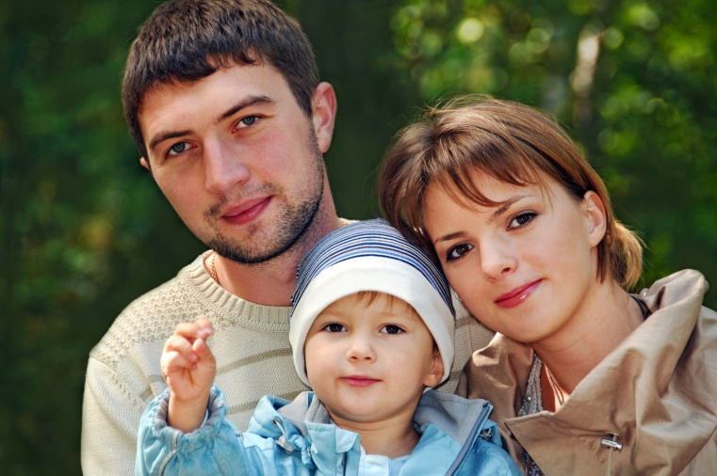
What is Relationship and Marriage Education (RME)?
Teaching principles and skills that can strengthen couple and co-parenting relationships.

Slide 7
Three Target Audiences: 1. Currently Married Couples
This includes biological parents, stepfamilies, grandparents raising grandchildren, and foster and adoptive parents.

Slide 8
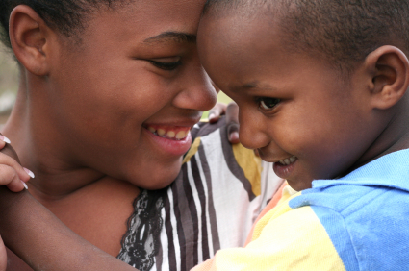
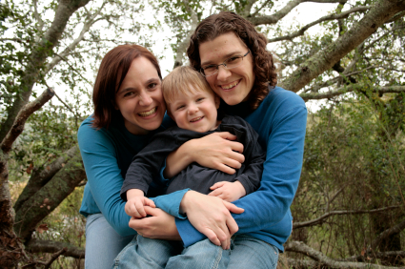
Three Target Audiences: 2. Unmarried Individuals and Couples
This includes unmarried parents/co-parents, single parents, single foster or adopting parents, single grandparents, cohabiting couples, and others.

Slide 9
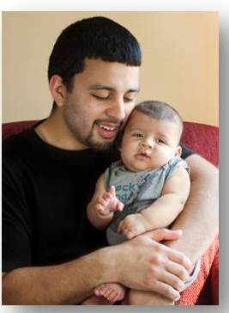
Three Target Audiences: 3. Youth
This includes youth in families referred to children’s services, foster children aging out of the system, juvenile delinquents, and other youth.

Slide 10
Who is NOT Included?
The tools presented are NOT intended for individuals who:
Currently experience domestic violence
Have severe emotional and/or mental health problems
Have severe alcohol or drug problems
These families FIRST require outside professional intervention, which is beyond the scope of relationship and marriage education.

Slide 11
Relationship and Marriage Education
How is this different than therapy or marriage counseling?
The goal of relationship and marriage education is to share knowledge, principles, and skills (prevention) that can reduce stress and help individuals and couples have happier relationships – at any stage of their relationship (even if parents no longer live together but they co-parent a child together).
Prevention/education vs. Intervention/therapy
Improve communication
Manage conflict productively
Handle differences in expectations
Work together as a team
Learning how to forgive and make
healthy sacrifice
Strengthen your trust in and
commitment to the relationship

Slide 12
Relationship and Marriage Education
Most of the individuals I work with are single parents – how is this going to relate to them?
Research shows that the majority of single parents will eventually become involved in a romantic relationship(s).
The knowledge, principles, and relationship skills can help them make better decisions when considering a romantic partner.
Few decisions they make will have a greater impact on the well-being of their child(ren) than the type of person they bring into their child’s life.

Slide 13
Couple Functioning, Parenting, and Child Outcomes
How are they related?
Couple Functioning
Child Outcomes
Parenting
Couple, parenting, and co-parenting relationships impact children’s safety and well-being.
Notes:
We know there are several factors related to child outcomes, with the majority of the focus centering on parenting. However, we also know from research that the quality of the couple relationship influencing both parenting and directly influences child outcomes.

Slide 14
Healthy Couples Healthy Parenting
What is good for kids?
Positive Parental Involvement
Positive Parenting Practices
Family Stability
HEALTHY
RELATIONSHIPS
ARE LINKED TO:
Parent Involvement
Positive Parenting
Family Stability
Notes:
Cowan and colleagues have said that “the single most powerful predictor of fathers’ engagement with their children is the quality of the men’s relationship with the child’s mother, regardless of whether the couple is married, divorced, separated, or never married.” (Cowan, Cowan, Pruett, Pruett, Wong, 2009, p. 665)

Slide 15
Healthy Parents – Healthy Children
Couple and co-parenting relationships impact children’s safety and well-being:
Couple Functioning
Child Outcomes
Parenting
Research also supports these direct paths
When children are physically abused, it is often in the context of a poor couple relationship
Notes:
Adults who experience high conflict and separation/divorce are at greater risk of depression, unhealthy stress levels, physical illness, and economic hardship, WHICH affects their parenting
When parents experience stress, they can’t think as clearly, and more likely to be harsh, and less likely to be warm, patient, compassionate, and empathetic.
Results in unhealthy outcomes for children.
This is true for:
Married couples,
non-married couples,
post-divorce couples
Low-income couples;
higher income couples
Ethnic majority couples;
ethnic minority couples
Mothers’ parenting and fathers’ parenting
Young children,
school-age children, and adolescents.

Slide 16
Stress Model of Effective Parenting
Poor
relationship quality
+

Slide 17
Couple Functioning, Parenting, and Child Outcomes
Couple Functioning
Child Outcomes
Parenting
Experiences during childhood have an influence on future romantic relationships
Notes:
We know that it’s not just child outcomes that influence later relationship quality (we know drug and alcohol abuse and incarceration, to name a couple, are factors that make it more difficult to develop and maintain a healthy couple relationship)

Slide 18
Unhealthy Relationship Cycle
Child protective services
Mental health services
Foster care
Intimacy
Personal relationship skills
Insecure attachment
Limited education
Economic challenges
Mental health problems
Alcohol/drug abuse
Early childbearing
Suicide attempts
Multiple sexual partners
Unintended pregnancy
Intimate partner violence
Child maltreatment
Physical/Emotional/
Sexual abuse
Neglect
Adverse childhood experiences
Negative Marital/Relationship outcomes
Higher stress
Harsher parenting
Child Maltreatment
Couple Functioning
Parenting
Notes:
Quality/Stability
Review Conway & Huston, 2008 – Healthy Marriage and the Legacy of Child Maltreatment: A Child Welfare Perspectivey/Frequency of Foster Care can have a HUGE impact

Slide 19
Couple Functioning, Parenting, and Child Outcomes
Couple Functioning
Child Outcomes
Parenting
Research has demonstrated:
• Evidence of elements of the couple relationship spillover into parenting. (El Sheikh & Elmore-Stanton, 2004)
• Evidence of links between couple functioning and individual well-being of the parent. (Seifer & Dickstein, 2000)
• Links between individual well-being of parent and parenting practices. (Seifer & Dickstein, 2000)

Slide 20
Child Abuse Prevention and RME
Preventing child abuse and neglect includes many approaches, including relationship and marriage education
Notes:
Ultimately, a Healthy Marriage Initiative is really a “Child-centered” initiative.

Slide 21
How does Relationship/Marriage Education “fit” with Protective Factors?
Nurturing and Attachment - “Ways to create and sustain healthy marriages that better support a nurturing home environment for children”
Knowledge of parenting and child development - modeling desirable behavior (how you treat your partner)
Parental resilience – “Faith communities, community colleges, self-help groups, and social service agencies can help parents and caregivers develop problem-solving and communication skills that strengthen their ability to deal effectively with crisis, so they can continue to provide for their children.”… “How stress affects parenting, marriage, and family life”
“Concrete skill building in areas such as problem solving, goal setting, communication, and self-care”
(http://www.childwelfare.gov/preventing/preventionmonth/factors.cfm)

Slide 22
A Strong Family Unit is Needed
“Over half a million American children suffer neglect or abuse every year. A strong and well-informed family unit is the surest defense against child abuse”.
- President Barack Obama, Proclamation, National Child Abuse Prevention Month, April 2012

Slide 23
Framework for Conceptualizing Relationships and Marriages Guiding Curriculum Development and Training
Micro-level Risk & Protective Factors
Healthy Relationship/ Marriage
Benefits/ Consequences
Background
Social context & Macro-level factors:
Race/Ethnicity
Culture
Social class
Regional & neighborhood characteristics
Immigrant status
Public policy
Employment/ Income
Education
Physical health
Mental health
Stress
Social support
Social skills
Substance use
Incarceration
Children from prior relationships
Community context
Religiosity
Attitudes/ values
Choose: Commit to the relationship
Know: Understand your partner
Care: Show kindness and affection
Care for Self
Share: Spend meaningful time together
Manage: Address conflict in healthy ways
Connect: Draw support from a social network
Adults
Employment, income, wealth
Physical health, mortality
Mental health
Social support
Satisfaction and happiness
Risk-taking, substance use, illegal activities
Parenting
Religiosity
Attitudes/values
Children
Socioemotional outcomes
Cognitive attainment and educational achievement
Health and safety
Attitudes/values towards marriage and child-bearing
Dating behavior
Sexual activity
Relationship skills
Marital stability of offspring
Attachment
Family background characteristics:
Parental marital status
Family SES
Parental mental & physical health
History of child maltreatment

Slide 24
National Extension Relationship and Marriage Education Model (NERMEM)
Each concept includes one-page “tools” for individuals/ couples

Slide 25
Overview - Care for Self: It Starts with Health
Physical Health
Eating right
Healthy amount of sleep
Physical activity
Avoiding harmful substances
Sexual Health
Healthy choices
Minimize risks

Slide 26
Overview - Care for Self: It Starts with Health
Social/Emotional Health
Notice and appreciate the small good things in life– past, present, and future
Identify, use, and build on strengths
Serve others – it feels good to do good
Spiritual Health
Helps to make sense of life. Gives life meaning, purpose, and guidance
Notes:
We don’t focus too much on physical health because of the little difference we are likely to make in their physical healthy practices (eating, smoking, drinking)

Slide 27
Overview - Choose: Making the Relationship a Priority
The deliberate and conscious decisions that strengthen relationships
Individuals who are NOT currently in a relationship and couples who ARE in a relationship
Choosing a partner and choosing to stay with a partner

Slide 28
Summary: Choose
Each partner must make intentional relationship choices by:
Deciding, not sliding
Committing effort to the relationship
Focusing on each other’s strengths
Avoiding hurtful thoughts or behaviors
Finding ways to grow your relationship
Envisioning a healthy future together

Slide 29
Overview - Know: Getting to Know Your Partner Well
Know involves developing an understanding of one’s partner and being willing to share personal hopes and dreams with each other
“Know before you go” and “Knowing as you are going”

Slide 30
Being in the Know: 10 Ps to Ponder
Personality
Passions
Plans and Priorities
Previous Partners
Perspective Taking
Problem Solving
Past Family Experiences
Physical/Psychological Health
Parenting Experience/Approach
Provider Potential
KNW-05

Slide 31
Summary: Know
Getting to know one’s partner well involves:
Asking about partner’s life, thoughts, and feelings
Being sensitive to partner’s worries and needs
Recalling positive experiences together
Expressing sincere interest
Revealing your thoughts and feelings
Discussing what you expect in the relationship

Slide 32
Overview - Care: Showing Affection and Respect
Some ways individuals show affection and respect to a partner include:
Expressing caring actions, not crabby reactions
Being open and listening to one’s partner
Focusing on the good in one’s partner
Accepting and valuing differences
Giving love in the way the partner likes to be loved
Showing appreciation
Making time for togetherness

Slide 33
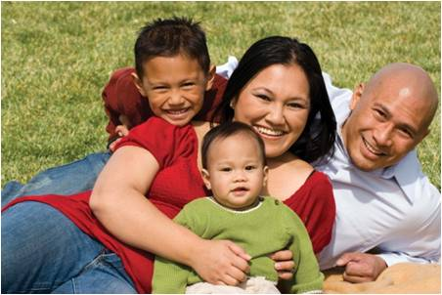
3 Parts to Every Relationship
Things that I like about my partner that do not need to change.
Things I do not like about my partner that never will change.
Things I do not like about my partner that can change.

Slide 34
Things That Do Not Need to Change…
Often people like about 80% of their partner and dislike 20%
What happens when we think and talk about the 20% we don’t like?
What happens when we think and talk a lot about the 80% that we do like?

Slide 35
Things That Do Not Need to Change…
Things that won't change
(70%)
70% of what we dislike will not change (e.g., personalities, food preferences, personal styles).
30% can change, but only when we focus on the good.

Slide 36
Overview - Share: Developing and Maintaining Friendship
While Care focuses on “doing” for one’s partner, Share focuses on what couples do together.
Share is about what a couple learns together, who they become together, and how they grow in love together.

Slide 37
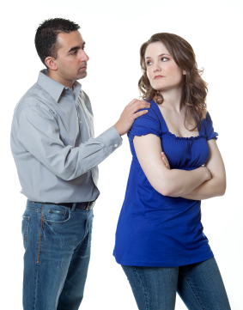
Bids for Connection
Create connection between two people.
Keep relationships moving in a positive direction.
Individuals constantly make bids – for affection, attention, and help.
How a partner responds to bids often separates happy from unhappy couples.
Notes:
How does this relate to children?

Slide 38
Examples of Bids
“Did you see all the new movies Redbox has now?”
“Turning away”
Ignoring the partner’s bid or continuing what he or she was doing.
“Turning against”
“Can’t you see I'm busy right now?” or “All you do is waste money on those dumb movies that you never return on time.”
“Turning toward”
“No, what movie did you want to get?” or “Should we rent one this weekend?”

Slide 39
Summary: Share
Strong couples develop and maintain friendship over time by:
Scheduling meaningful time together
Finding common interests and activities
Creating couple traditions and rituals
Working towards common goals
Nurturing positive interactions
Sending clear and positive messages
Turning toward partner’s bids for connection
Envisioning themselves as a “team”

Slide 40
Overview - Manage: Handling Stress and Differences
Manage focuses on a couple’s use of strategies to stay calm, contain their stress response, soothe their partner, listen attentively, make an effort to understand their partner’s point of view, accept differences, and forgive one another.
Many problems in long-term, healthy couple relationships are never resolved. Instead, couples work to manage them.

Slide 41
How We Respond to Threats
A real or perceived threat initiates a reaction in our bodies that limits our capacity to listen, talk, and handle conflict in a healthy way.
Common reactions:
Fight
Flight
Freeze (or shut down)

Slide 42
Threats Affect our Minds and Bodies
Trigger – Real or perceived threat or attack.
Escalation – Our bodies prepare for action, get tunnel vision.
Crisis – Verbal and/or physical action (fight, flight or freeze).
Recovery – Depends on physiological and psychological makeup, intensity of response, and how long we dwell on it.
Post crisis – Heart rate drops below normal to counter the increase in chemicals.
We examine our thoughts and behavior; feel guilty, depressed.
May avoid the person and/or the issue.

Slide 43
Managing Relationship Problems
Even the happiest couples have some problems.
Strategies for managing conflict:
Soften your startup
Learn to make and receive repair attempts
Soothe yourself and each other
Search for common ground
Show acceptance and understanding
“Relationships will work to the extent that you have wound up with a set of perpetual problems you can learn to live with.” -- John Gottman

Slide 44
Summary: Manage
Conflict in relationships is inevitable, and healthy couples deal with differences in healthy ways:
Understanding there cannot always be agreement
Sharing concerns in a calm, respectful tone
Avoiding criticism and defensiveness
Stopping conflict before it escalates
Taking “time outs” but coming back to talk
Soothing and supporting each other
Being open to forgiveness
Maintaining emotional and physical safety

Slide 45
Overview - Connect: Engaging a Positive Social Network
Couples strengthen their relationships by engaging positive social networks in various ways:
Growing and maintaining extended family relationships
Being part of a supportive network of friends
Engaging jointly in community organizations and service
Seeking out resources to strengthen the relationship

Slide 46
Summary: Connect
Couples strengthen their relationships by engaging positive social networks in various ways:
Growing and maintaining extended family relationships
Being part of a supportive network of friends
Engaging jointly in community organizations and service
Seeking out resources to strengthen the relationship

Slide 47
Summary of Results
28 trainings across 5 states – 703 participants (MO, IA, AR, GA, NC)
Pre, post, 1 week, 2 month, 6 month
Survey questions related to:
General attitudes about marriage and couple relationships
Perceptions of helpfulness, relevance, and how appropriate it is for CWPs to receive RME training
Level of knowledge, abilities, comfort, and awareness of RME and RME resources
Confidence in providing RME to individuals/families

Slide 48
Results Summary - 218 CWPs
Training positively influenced participants’ perceptions and beliefs about the value of marital preparation and healthy couple and marital relationships on successful parenting.
Training affected how participants felt about working with clients and families on healthy relationship issues, with more favorable views on the relevance of RME to child welfare professionals following the training.
Notes:
166 completed pretest, posttest, and 1 week

Slide 49
Results Summary - 218 CWPs
Most of the participants indicated that the training was useful and relevant, and particularly favored the tools and skills they had opportunities to practice in training and apply afterwards.
At both 2- and 6-months following the training, the majority of respondents reported using the content in their work, with many different ways of applying information documented.
Training impact continued to appear 6-months following the training, with levels of knowledge, ability and comfort, resource awareness, and confidence remaining higher than pre-training levels.

Slide 50
General attitudes regarding marriage and relationships
Overall, respondents’ attitudes were positive and consistent over time. On average, 77% (M=3.84; SD=0.51) at pretest and 88% (M=4.01; SD=0.51) at one-week posttest agreed about the importance of marital preparation, intentionality, and strong couple/marital relationships on successful parenting.
“I see couples that are able to work together make much faster and lasting progress than couples that do not. A lot of child abuse and neglect issues arise directly from poor relationships of the parent(s). I see often that children cannot be returned to home due to relationship issues.” (MO)
“Overall, I am excited to see what you are doing, as it is crucial in my opinion to look at the relationship of the parents; otherwise it seems that we are just applying bandaids and not looking at ways to keep children safe in their homes and reducing child abuse.” (IA)
Notes:
Because the training being developed was funded with the intent to facilitate the formation and stability of healthy marriages, respondents were asked a series of questions (five items) to gauge their views on marriage in general
Sample q’s
“Strong marital/couple relationships lead to successful parenting”
“All couples should receive marriage education before getting married.”

Slide 51
Relationship and Marriage Education in Child Welfare
Majority of participants agreed or strongly agreed that RME was relevant to their clients (Pre: M=4.16, SD=0.50; Post: M=4.19, SD =0.53) and their job (Pre: M=4.14, SD=0.46; Post: M=4.17, SD=0.54)
“I’ve worked with children and families in the past and can honestly say having a healthy relationship/marriage does impact the children in a positive manner as well as reduce the risk of harm to the children.” (AR)
“As a child abuse assessment worker (CPW) we are doing a number of assessments regarding domestic violence in the home, which may place the child at risk. Parental relationships have a big impact on a child's well being. Any information to assist with working with these families will be appreciated.” (IA)
Notes:
Next, given the focus of the training, questions were asked of participants to determine how they viewed the potential helpfulness and relevance of healthy relationship and marriage education (RME) in the child welfare field.
2 Questions:
“Child welfare clients’ participation in marriage/relationship enhancement programs can help reduce incidences of child abuse and neglect.”
“The clients I work with can benefit from participating in programs that focus on enhancing marriage/couple relationships.”

Slide 52
Relevance of RME to Child Welfare Professionals
Perceptions of the helpfulness of RME training and the appropriateness of CWPs offering RME were positive at both pre- and post-test, with slight increases observed in perceived appropriateness following the training.
“It would be helpful to attend training on supporting healthy relationships and marriages, but we don't work with people who typically have healthy relationships at the time we are working with them. We need training on how to work with people in dysfunctional relationships and be able to help them improve their relationship!” (IA)
Notes:
Further, participants were also asked to report on the helpfulness and the appropriateness of child welfare professionals (CWPs) being trained in and offering relationship and marriage education (RME
“The knowledge and skills I learn about working with couples will help me perform my job more effectively. “
“Child welfare workers need knowledge and skills about enhancing marriage/relationships in order to do their job more effectively.”
“Understanding characteristics of healthy marital/couple relationships will strengthen my assessment and case planning skills to reduce abuse/neglect.”

Slide 53
Relationship/Marriage Education Training Impact
Participants’ knowledge of ways to incorporate healthy relationship and marriage education and information into aspects of their job noticeably improved following the training (36% agreed or strongly agreed on having knowledge in this area at pretest , 87% one week posttest).
Participants’ ability and comfort with incorporating healthy relationship and marriage education into aspects of their job noticeably improved following the training (47% agreed or strongly agreed on having the ability and comfort with offering RME at pretest, 91.5% one week posttest.
Notes:
The participants were asked in the pre-test, and again at the one-week follow-up, about their knowledge, abilities, comfort, and resource awareness related to incorporating healthy marriage/relationship education and information into case planning, assessment, and practice.
You can see the significant increases in knowledge about ways to incorporate this into their work as well as their comfort and ability to do so.

Slide 54
Relationship/Marriage Education Training Impact
Only 57% agreed or strongly agreed that they were aware of such resources at pre-test—86% at one week posttest.
Nearly 75% reported they improved ‘somewhat’ or ‘a lot’ in knowledge and about 65% felt similarly regarding their improvement in ability/comfort and awareness of resources to assist them.
Notes:
We also looked at the change in awareness of resources, including local educational and counseling services that can assist healthy couple formations as well as their perceived overall improvement related to their awareness, knowledge, abilities.

Slide 55
Relationship/Marriage Education Training Impact
Immediately following the conclusion of the training (post-test), all of the participants felt confident in helping individuals and couples apply the core concepts taught from the (NERMEM)
Felt Confident or Very Confident in (7 HRMET concepts):
Helping individuals and couples develop and maintain a healthy and committed relationship (74%)
Develop shared intimate knowledge (76%)
Demonstrate care in their relationships (90%)
Support healthy living choices (91%)
Establish meaningful couple time (86%)
Manage differences and conflicts (80%)
Become better connected to support systems (84%)
Notes:
Changes in Confidence

Slide 56
Sample comments from CWPs and what they will do differently
“[I plan to] help my families strengthen their relationships by finding ways to care for each other and manage conflict. I didn’t have a lot of training on that before and now I feel like I know where to begin.” (IA)
“[I will be able to] identify issues in relationships more clearly and be able to look toward/point to possible areas of concern.” (IA)
“[I will] recognize the needs of the couple and appropriately offer them the tools they need.” (MO)
“I will likely start a couple’s group at the VA or a parenting group for couples.” (AR)
“Identify community resources that may be able to assist before the family irretrievably deteriorates.” (GA)

Slide 57
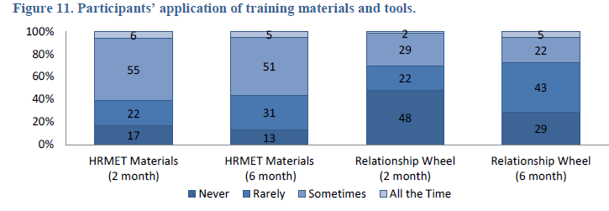
Posttests at 2 months & 6 months
Notes:
Approximately two- and six-months after completing the course, participants were emailed and asked to complete a follow-up survey on how they have used the HRMET information and materials in their work. From the participants who were emailed following the training, 128 responded to at least one of the follow-up surveys: 111 at two-month follow-up and 85 at six-month follow-up.
Participants were asked how often they had used (1) the materials as a whole that they received during the training, and (2) the Relationship Wheel

Slide 58
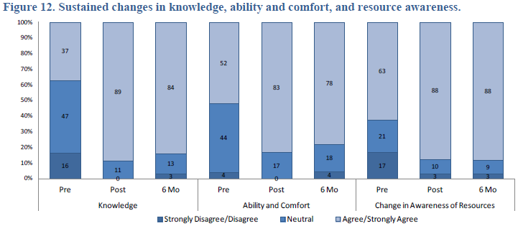
Pre, Post, and 6 Mo follow up

Slide 59
How the information has been implemented
“I have given the tools to my workers and they are using them with my families. One family in particular used to have domestics frequently hasn't had 1 in about a 2-month period. That is HUGE. It used to be weekly.” (IA)
“In working with a couple who have been physically abusing their children, I have been able to make the connection with them about sharing, caring, and they have been open to that information.”(GA)
“I used the list of things to consider before committing to relationship with several people. This morning it helped a young man become clearer about his decision to go forward with his relationship or not.” (AR)
“[I] used the wheel to show how they can be working together more as mother and father for their children.” (MO)

Slide 60
Upcoming HRMET Trainings in MO
April 10 – Jefferson City
May 1 – St. Louis
June 4 – St. Louis
June 19 – Blue Springs
June 26 – Kansas City
July 25 – Kirksville
Free for Child Welfare Professionals (work directly with families). Contact Kelly for more information: 573-882-3521 or warzinikk@missouri.edu
Free online training coming soon!

Slide 61
Summary
For more information visit www.HRMET.org and www.NERMEN.org
Schramm, D. G., Futris, T. G., Galovan, A. M., & Allen, K. (2013). Is relationship and marriage education relevant and appropriate to child welfare? Children and Youth Services Review, 35, 429-438.
Questions?

