Slide 2

Child Abuse and Neglect Prevention Conference
Robert W. Block, MD, FAAP
Immediate Past President (2012-2013) The American Academy of Pediatrics

Slide 3

What Is An Eco-Bio-Developmental Model of Childhood:
Why Is It Important?

Slide 4

Social Determinants of Health:
Lifetime Consequences of Maltreatment;
Children as the Key to Lifespan Health;
Brain Development Related to Social Determinants.

Slide 5

Disclosure:
  I have no relevant financial relationships with manufacturers of any commercial products nor provider of commercial services discussed in this CME activity.
  I do not intend to discuss unapproved/investigative use of a commercial product/device.

Slide 6
Why Are Social Determinants Important?
The Heckman Equation
Felitti, Anda: The Adverse Chidhood Experiences (ACE) Studies
Evolving Science in Brain and Human Development
  The Effects of Toxic Stress

Slide 7
United States Government Action Plan on Children in Adversity
The Goal of the Plan is to achieve a world in which all children grow up within protective family care and free from :
  Deprivation
  Exploitation
  Danger
The plan is grounded in evidence that shows a promising future belongs to those nations that invest wisely in their children, while failure to do so undermines social and economic progress.

Slide 8
Health and Economics
While not all children are able to become adults, it is certainly true that all adults once were children.
Developing science underscores the need to invest in children’s health, education, and general well-being in order to avoid the continuation of an unsustainable health care system, and a failing system of education.

Slide 9
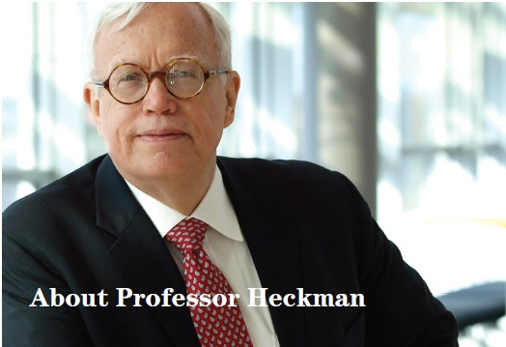
James J. Heckman
Nobel Memorial Prize Winner
Professor of Economics, University of Chicago
Equation on Human Capital Development is a Solution for Securing America’s Economic Future.

Slide 10
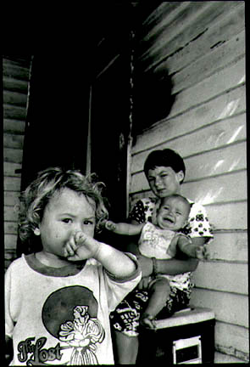
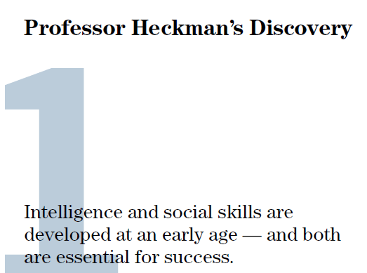

Slide 11

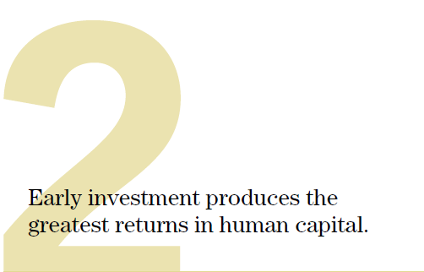

Slide 12
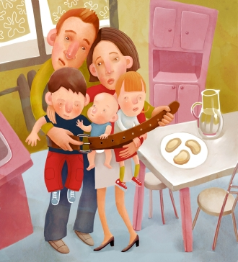
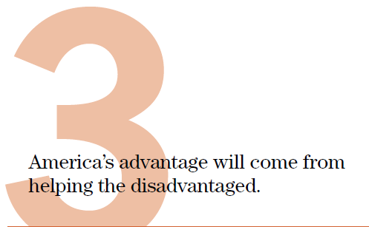

Slide 13

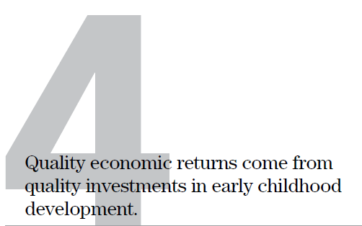

Slide 14
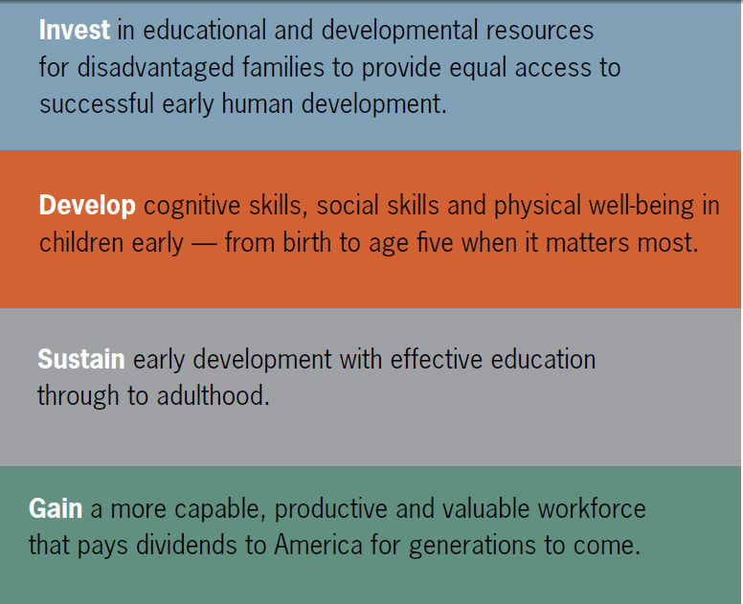
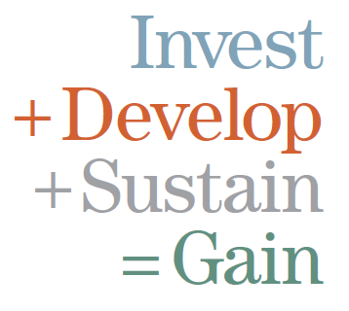

Slide 15
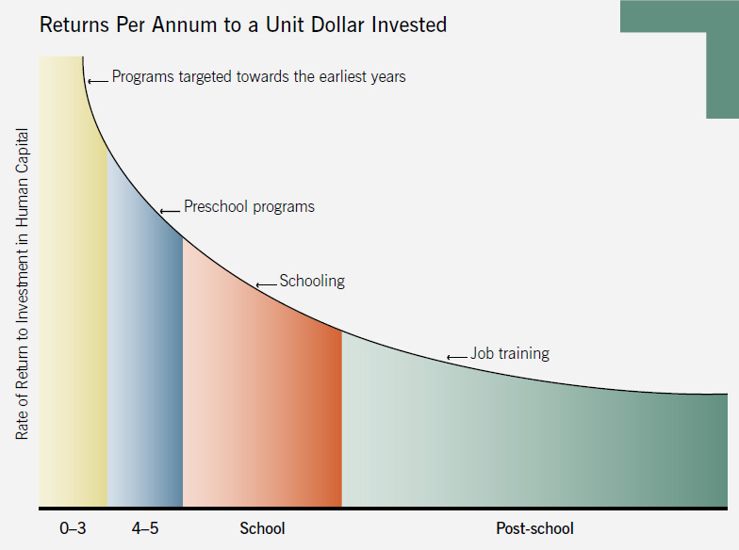
THE HECKMAN EQUATION

Slide 16
What determines health?
Genetics
Pre –and perinatal factors
Physical health
Gender
Trauma
Biological
Social/Cultural
Psychological
SES
Family stability
Social capital
Work/employment
Value system
Neighborhood/Housing
Religion
HC Policy
HC System
Relations with parents/siblings
Family dynamics
Personality
Resilience
Adaptability
Notes:
http://cnx.org/content/m13589/latest/
16

Slide 17
ACCESS → Access to and equity in healthcare are key health determinants.
NORTH TULSA
Shorter Life Expectancy
14 Year difference
in Life Expectancy
SOUTH TULSA
Longer Life Expectancy
Notes:
17

Slide 18
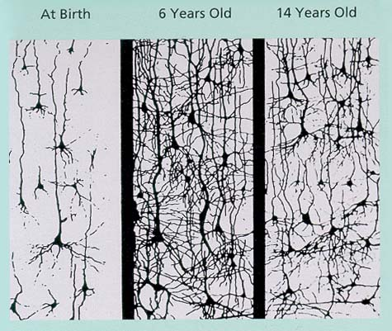
Brain Development
Notes:
Brain growth is fastest in first 3 years of life.
Synapses peak at age 12 .
Pruning occurs during late teen years.
Neurogenesis continues later into life with new cells concentrating in memory, planning, decision making and emotional areas of brain.
18

Slide 19
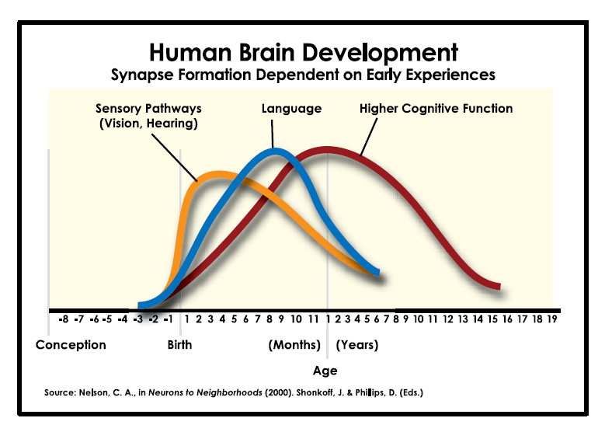
Notes:
19

Slide 20
Developing a Model of
Human Health and Disease
Biology
Physiologic Adaptations and Disruptions
Epigenetics
Ecology
The social and physical environment
Development
Learning, Behavior
And Health
Life Course Science
Through epigenetic mechanisms,
the early childhood ecology becomes
biologically embedded, influencing how the genome is utilized

Slide 21
Eco-Bio-Developmental Model
Eco: = Ecology (The environment of family, neighborhood, community, support, access to health care, education, and other factors.
Bio: = New discoveries daily that link health over the lifespan to early childhood Biologic responses to ecologic and other factors.
Developmental: = The SCIENCE of human development, emphasizing opportunities for habilitation and rehabilitation.

Slide 22
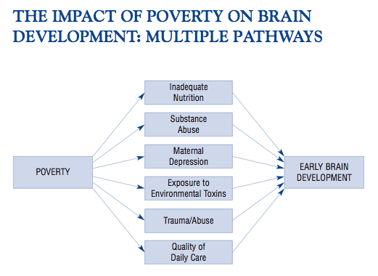
Brain development in the context of poverty
Notes:
22

Slide 23
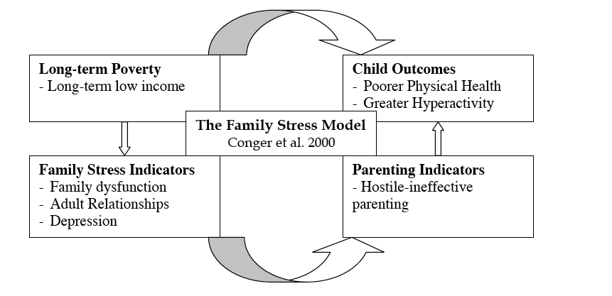
Hardship & Stress, Isolation & Exclusion, Adverse Health
Notes:
23

Slide 24
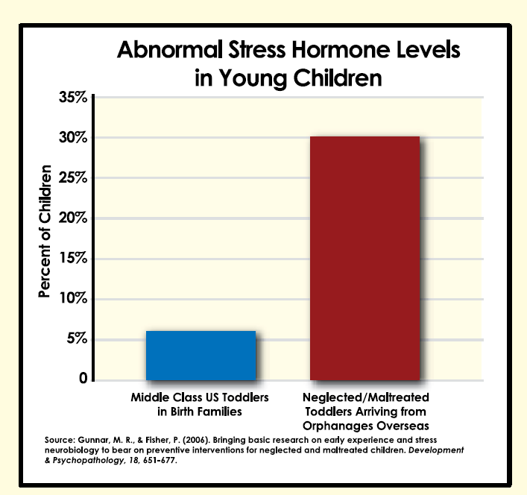
Notes:
24

Slide 25
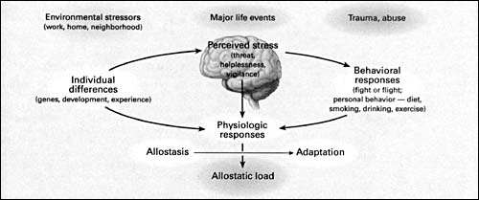
Allostasis and Allostatic Load
Notes:
Thus allostatic load reflects, in part, genetically- or developmentally-programmed inefficiency in handling the normal challenges of daily life related to the sleep-wake cycle and other daily experiences, as well as the adverse physiological consequences of a fat-rich diet, drinking or smoking.
Psychol Sci. 2007 Nov;18(11):953-7.Click here to read Links
Childhood poverty and health: cumulative risk exposure and stress dysregulation.
Evans GW, Kim P.
Department of Design and Environmental Analysis, Cornell University, Ithaca, NY 14853-4401, USA. gwe1@cornell.edu
A massive literature documents the inverse association between poverty or low socioeconomic status and health, but little is known about the mechanisms underlying this robust relation. We examined longitudinal relations between duration of poverty exposure since birth, cumulative risk exposure, and physiological stress in two hundred seven 13-year-olds. Chronic stress was assessed by basal blood pressure and overnight cortisol levels; stress regulation was assessed by cardiovascular reactivity to a standard acute stressor and recovery after exposure to this stressor. Cumulative risk exposure was measured by multiple physical (e.g., substandard housing) and social (e.g., family turmoil) risk factors. The greater the number of years spent living in poverty, the more elevated was overnight cortisol and the more dysregulated was the cardiovascular response (i.e., muted reactivity). Cardiovascular recovery was not affected by duration of poverty exposure. Unlike the duration of poverty exposure, concurrent poverty (i.e., during adolescence) did not affect these physiological stress outcomes. The effects of childhood poverty on stress dysregulation are largely explained by cumulative risk exposure accompanying childhood poverty.
25

Slide 26
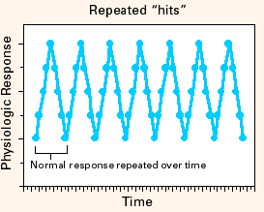
Positive & Tolerable Stress
Notes:
26

Slide 27
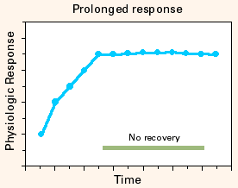
Toxic Stress
Notes:
27

Slide 28
Adversities During Childhood and Toxic Stress
Pediatrics 2012;129:e224-e231
Pediatrics 2012;129:e232-e246

Slide 29
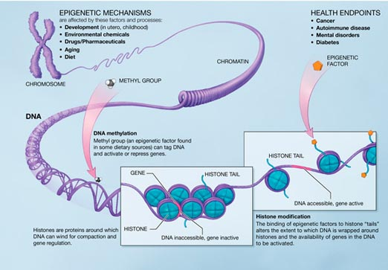
Epigenetics
Notes:
29

Slide 30






How Does Social Environment get Embedded into Biology?
Poverty
Stress
Unmet needs
1. Material
↓ Food
↓ Money
↓ Access
↓ Housing
2. Caregiving
Emotional
Learning
Neighborhood
Air
Water
Soil
Parks
Libraries
Violence
HPA
Gene experience
Brain
Immune
CV
Poor Health in Childhood and Adulthood
Notes:
30

Slide 31
There is NO Such Thing as Mental Health!
Why the term “Brain Health” might better represent reality.
Brain disease can then be equal to heart disease, or liver disease.

Slide 32

Social Environment: Example One
Survey of 67,853 Nurses
  Report childhood physical abuse: 54%
  Report childhood sexual abuse : 34%
Increased Risk for Adult Type 2 diabetes:
26% – 69%, for moderate to
severe abuse.
Am J Prev Med, 12/2010

Slide 33
Example Two
Survey of 68,505 Nurses
Risk of Uterine Fibroids with increasing severity of childhood abuse:
8% - 36%!
Also found that an emotionally supportive relationship during childhood was protective against this risk.
Jarrett RB, Epidemiology, 11/2010

Slide 34
A More Recent Example
Wise, L. American Journal of Obstetrics and Gynecology:
Among African-American Women, the risk for uterine fibroids associated with sexual abuse = 34% increase,
For association with physical abuse = 16% increase.
With better coping skills, risk decreases toward normal.
Presumed effects of mental stress on sex steroid hormones. (an association, not proved to be causal)

Slide 35

Example Three
Interpersonal Violence (IPV), and “Housing Disarray” cause (or, are associated with) an increase in incidence of childhood asthma.
Cumulative or Multiple Stressors are most important.
J Epidemiol Community Health, 2010

Slide 36
Example Four
Among women with chronic pain syndromes, childhood maltreatment histories were associated with increased diurnal cortisol levels.
Abuse can lead to long-term changes in HPA activity.
Important to evaluate childhood experiences in fibromyalgia and pain syndrome patients.
Nicolson NA, et al, Psychosomatic Medicine, 2010

Slide 37
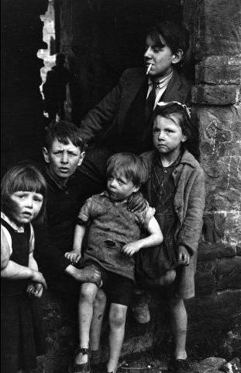
Example Five
Poverty, mediated by chronic stress –
Associated with decreased working memory in young adults.
Evans GW, Schamberg MA, Proceedings
of the National Academy of Science, 2009

Slide 38
Last Example
Childhood Traumatic Stress –
Increases the likelihood of hospitalization with a diagnosed autoimmune disease, “decades into adulthood.”
Dube SR, et al, Psychosomatic Medicine, 2009

Slide 39
Adverse Childhood Experience (ACE) Study
Adverse Childhood Experiences (ACEs)
are very common
ACEs are strong predictors of later
health risks and disease
This combination makes ACEs the leading determinant of the health and social well-being of our nation
Recurrent physical abuse
Recurrent emotional abuse
Contact sexual abuse
An alcohol and/or drug abuser in the
household
An incarcerated household member
Someone who is chronically depressed,
mentally ill, institutionalized, or suicidal
Mother is treated violently
One or no parents
Emotional or physical neglect
Notes:
The Adverse Childhood Experiences (ACE) Study
The largest study of its kind ever done to examine the health and social effects of adverse childhood experiences over the lifespan (18,000 participants)
39

Slide 40
Adverse Childhood Experiences
Score
Number of categories adverse childhood experiences
are summed …
ACE score Prevalence
0 48%
1 25%
2 13%
3 7%
4 or more 7%
More than half have at least one ACE
If one ACE is present, the ACE Score is likely to range from 2.4 to 4
Notes:
7

Slide 41
Childhood Experiences vs.
Adult Alcoholism
4+
3
2
1
0

Slide 42
Childhood Experiences
Underlie Suicide
4+
3
2
1
0

Slide 43
Childhood Experiences
Underlie Suicide
4+
3
2
1
0

Slide 44
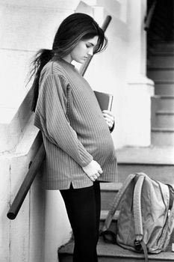
Health Consequences of ACE
More likely to smoke, have problems with drugs and alcohol
Chronic Obstructive Pulmonary Disease
Depression
Fetal death
Health-related quality of life
Ischemic heart disease
Liver disease
Risk of intimate partner abuse
Multiple sexual partners
Suicide attempts
Unintended pregnancies
Notes:
44

Slide 45
Missouri Data
Children with an ACE score of 1: 26.1%
Children with an ACE score of 2: 23.7%
Children with either 1 or 2 adversities: 49.8%

Slide 46
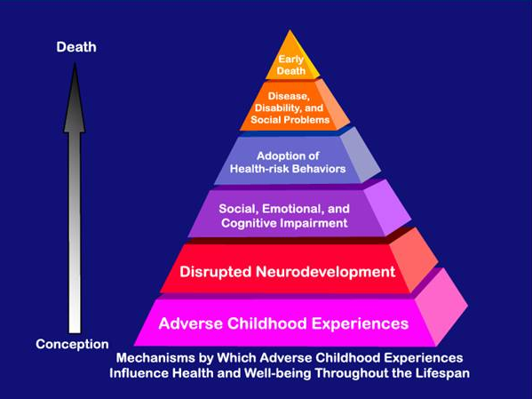

Slide 47
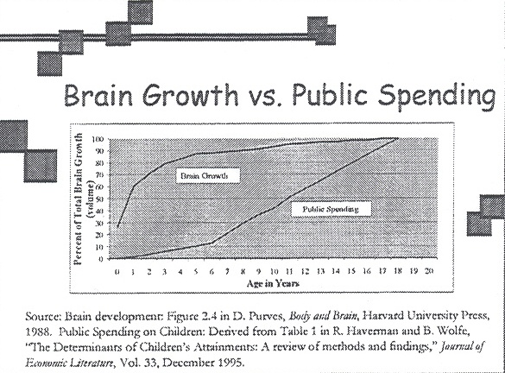

Slide 48
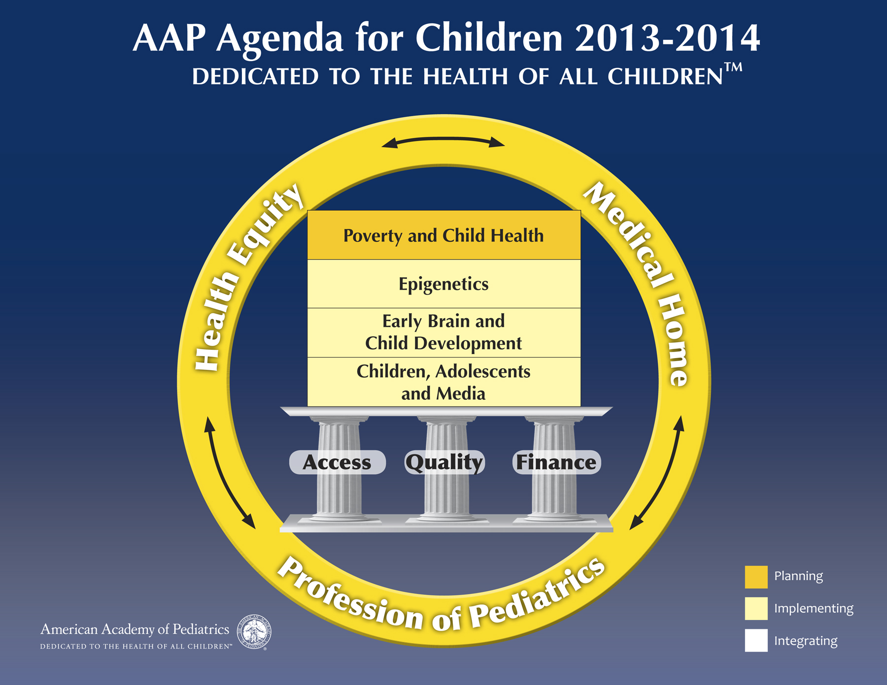

Slide 49

What are YOUR Thoughts?
How do We Achieve:

Slide 50

Why would anyone, anywhere, question
the importance of protective rights for
children? Why would anyone, anywhere,
question the profound effect children’s rights have on community well-being?

Slide 51

A powerful concept that sensibly ties in
thousands of years of observation with
emerging science is the unique vulnerability of children to adversity and toxic stress. William J. Keenan
Children's Rights and Community Well-Being
Pediatrics 2013;131;3; originally published online December 24, 2012;

Slide 52
Important Words
We are true to our creed when a little girl born into the bleakest poverty knows that she has the same chance to succeed as anybody else, because she is an American, she is free, and she is equal not just in the eyes of God, but also in our own.

Slide 53
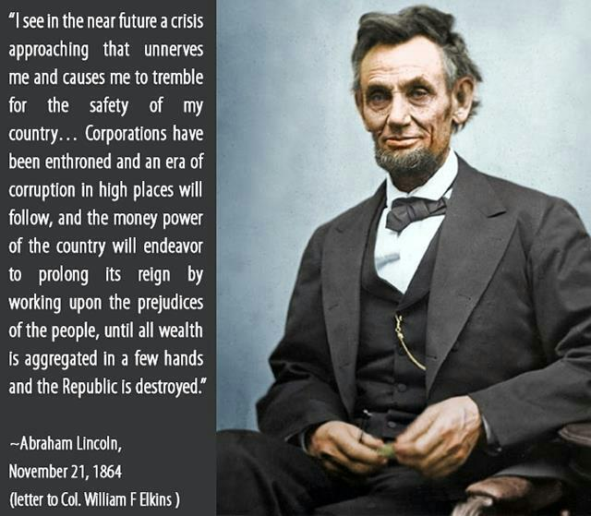

Slide 54
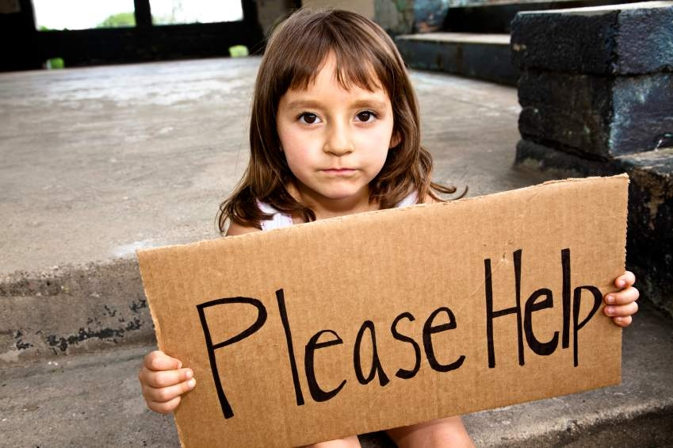
“The rising child poverty rate is an indictment of America. To have 22 percent of children living in poverty is unacceptable. We are marching in the wrong direction, and we cannot continue to cut essential services for children and families and remain a strong nation.” –Children’s Leadership Council

Slide 55
Only three other countries in the developed world have a higher child poverty rate than the U.S., according to the Organization for Economic Cooperation and Development. Mexico leads all nations with a rate of 25.79, followed by Chile (23.95), Turkey (23.46), and the U.S. (21.63).

Slide 56

Behind Every Data-Point, There Is A Child!

Slide 57
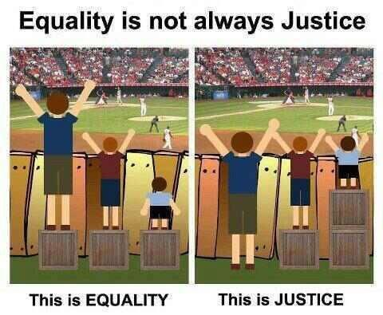
It’s Not Fair!!!

Slide 58
Fragile Families
Most dire straits: without protective family care.
Exposed to violence, exploited, abused, abandoned, severely neglected, homeless, in institutions, trafficked, gang members, exploited for labor.
Poverty plays a role: Disease, health risks, disabilities, social problems, disasters.

Slide 59
The Importance of Neglect
Absence of:
  Sufficient Attention – i.e. “Responsive Care!” Tennis anyone? Serve and Return.
  Responsiveness
  Protection.
  All appropriate for the age of the child.
  Processing information, cognitive, social, and emotional capacities (competencies) are distorted.

Slide 60
“Child Welfare”
Prevention, Identification, Rehabilitation.
Removal from family alone is insufficient to correct!
THERE SHOULD BE NO SUCH THING AS NON-THERAPEUTIC FOSTER CARE.
Therapeutic: Trained families with in-home support and therapy for both foster parents, their children, and the foster children they serve in their homes.

Slide 61

Realizing optimal goals requires resources!!
Child Welfare Agencies = Limited Capacities
We have a gap between Science and Policies – It’s called: Politics

Slide 62
Upside-Down Economics
Dollars Spent on Prevention vs Long-Term Costs
2008 Data:
  772,000 reports of abuse and neglect
  1,740 deaths (est)
COST (lifetime: per case of maltreatment) (average age of “entry” = 6 years):
$210,000/case
$1,273,000/death
Total Cost: $124 Billion dollars (up to $585 Billion)
  [sensitivity analysis: if all investigated cases were abuse]

Slide 63
Heckman Ingredients for Successful Human Development
Powerful role of a functioning family,
The prime importance of early years,
Developing multiple capabilities,
Capabilities interact to shape future capabilities,
Important features: not just poverty, but also lack of attachment, encouragement, and emotional/cognitive support,
Later life matters! Habilitation and rehabilitation.
Give struggling adolescents a second chance.

Slide 64
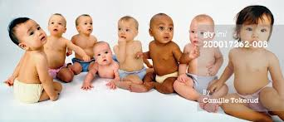
PREDISTRIBUTION

Slide 65
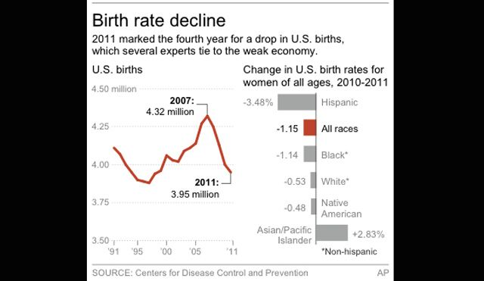

Slide 66
Four Million Children/Year
Average state expenditure for public schooling:
  $7,000 - $18,000 per year/per student for kindergarten through high-school.
Why not begin at age ZERO?
For ages zero-three, that would be (average) about $50,000,000,000 per year.
Think about return on investment (Heckman)

Slide 67
Because Things Don’t Always Turn Out The Way We Think They Should ----

Slide 68
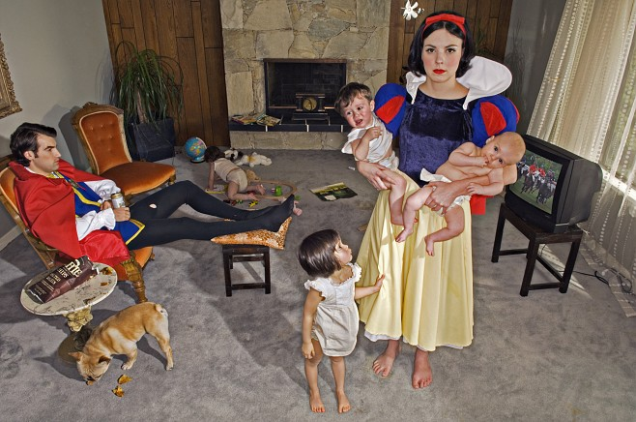
It’s Time To Convert What You’ve Heard into Appropriate Action

Slide 69
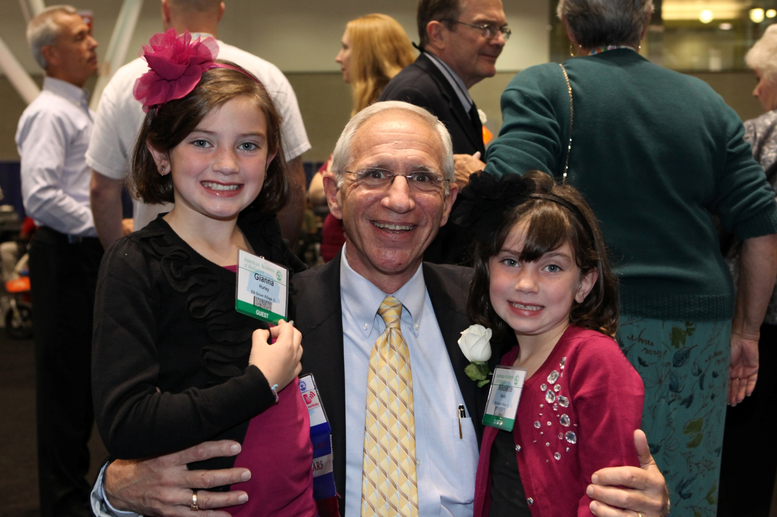
Thank You for Inviting Me!

