Slide 1
Department of Social Services Home Visiting Program
Presented by Tasha Toebben, Children’s Division Safety and Prevention Unit Manager

Slide 2
Funding Distributed
$4,225,147.10 is currently distributed for the Home Visiting program for FY19.
$3,382038.90 for competitive awards $543,108.20 for partnership awards
Funding provided through Missouri General Revenue (GR) and Temporary Assistance for Needy Families (TANF)

Slide 3
Counties Served
The Home Visiting program is located in 11 regions across the state.
8 Partnership Agreements
11 Competitive Contracts
57 counties currently served statewide

Slide 4
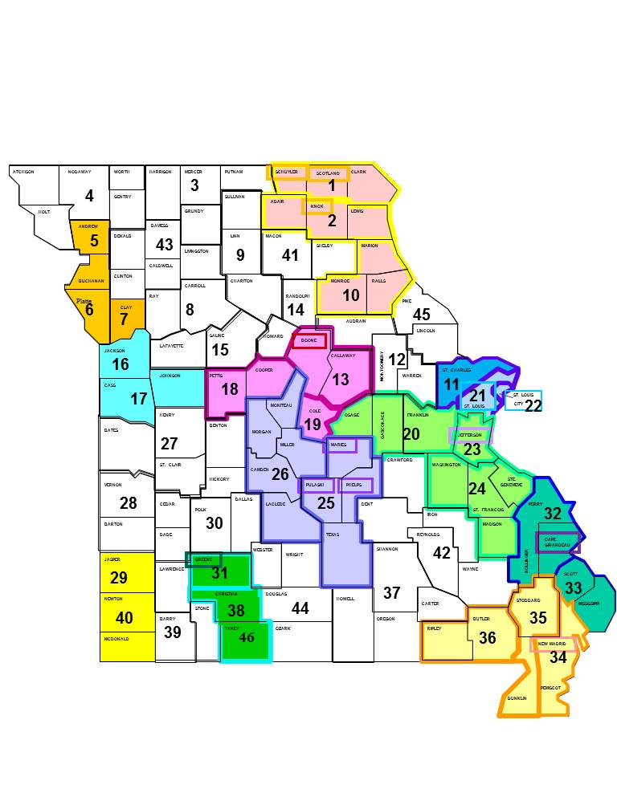

Slide 5
Models Supported by the DSS Home Visiting Program
Supported home visiting models
Healthy Families America-Healthy Babies Healthy Families Curriculum
Nurturing Skills for Parents
Nurse Family Partnership
Promising approach model
Capable Kids and Families
Home visiting models currently being utilized
Healthy Families America
Nurturing Skills for Parents
Capable Kids and Families

Slide 6
Outcome Data Collected
On a monthly basis, the following information is collected from each provider:
Number of families enrolled
Identifying information for each nuclear family
Number of home visits completed
Number of unduplicated families enrolled (families who have never previously been enrolled in the HV program
Number of CD involved families enrolled
Number of ineligible families
Number of families who declined services
Number of newborns (0-11 months) served
Number of 1 year olds served (12-23 months)
Number of 2 year olds served (24-35 months)
Number of prenatal women served

Slide 7
Outcome Data Collected cont.
Based on the identifying information received on each enrolled family, child abuse/neglect (CAN) data is then ran to collect the following data in order to show the overall success in reducing the risk of child abuse and neglect…
Number of substantiated investigations on families after services were initiated
Number of family centered services cases opened after services were initiated
Number of children who entered alternative care after services were initiated

Slide 8
FY18 Home Visiting Outcome Data
1880 families served
2208 children (aged 0-3 years) served
95% of families who participated in the Home Visiting program did not have a substantiated CA/N investigation in the same fiscal year
95% of families who participated in the Home Visiting program did not have a family centered services case after HV services began
96% of children who participated in the Home Visiting program remained intact with their families after services began

Slide 9
DSS Home Visiting Program
Primarily a secondary prevention program
With the DSS Home Visiting (HV) program targeting populations at a higher risk of child maltreatment and requiring providers to serve 70% Children’s Division (CD) involved and/or referred families, it is identified as a secondary prevention program
Families are being referred by the general public as well as CD affiliated individuals
Families are being referred when they come to the attention of CD however often times indicated maltreatment has not occurred, but there is a higher risk for child maltreatment
Some research has suggested that key features of successful home visiting programs in addressing child maltreatment include targeted recruitment of “at risk” families through secondary prevention measures; this is shown in the HFA model developing a child welfare adaptation specifically geared towards families involved in the child welfare system.
The DSS Home Visiting program also serves as a tertiary prevention program
Families are also being referred when child maltreatment has already occurred and they are working towards reunification with their children
The DSS HV program is designed to remain in the home of reunited families even after CD closes their case to ensure continuity of services

Slide 10
DSS Home Visiting Program
The Home Visiting (HV) program has proven to be not only a valuable resource for our Children’s Division (CD) families, but also our CD staff…
Oftentimes families, as well as CD staff, have limited access to resources that could otherwise prevent the likelihood of children coming into state custody, which causes trauma in and of itself.
The HV program is of no cost to families and is voluntary, which aids in the likelihood of the families being personally invested in the program.
Not only is the HV program providing hands on education to families at risk of child abuse/neglect, but it is also aiding in preventing the future risk of child abuse/neglect.
There is always room for improvement, if as a state we could have collective data then we would be able to better represent the need for HV and the positive outcomes.
The state would also benefit from increased collaboration to ensure all families receive the best services to meet their need regardless of the funding source.

