Slide 1

Promise 1000:
Home Visiting for Kansas City

Slide 2
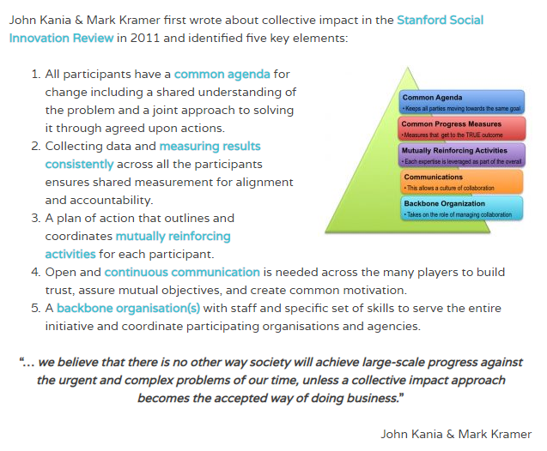

Slide 3
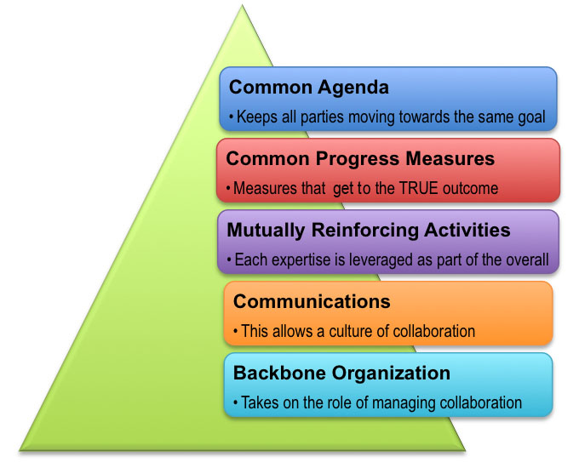
Collective Impact Model

Slide 4
Strategic Planning:2013
Challenges identified by HV agencies
  Multiple funding sources with varying reporting requirements & stability
  Data collection for outcomes analysis and reporting
  Recruiting and maintaining referral sources, or service advertisement
Challenges noted by users/referral sources
  Varying, confusing eligibility requirements
  Varying, confusing service areas
  Varying, confusing referral process

Slide 5
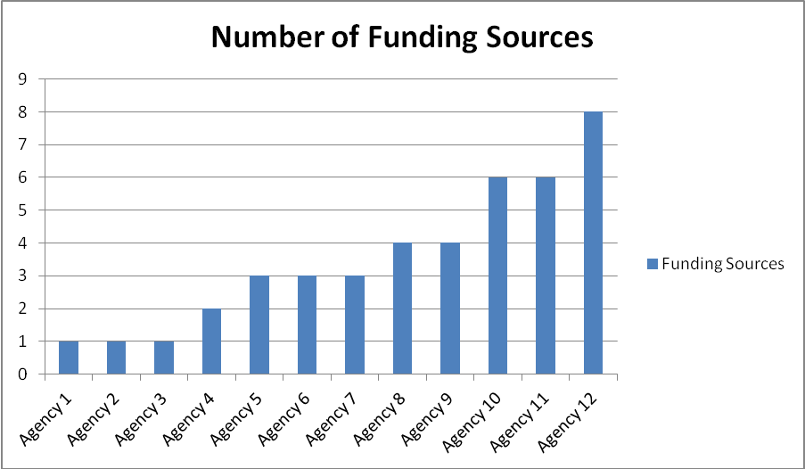
Home Visiting-Kansas City
Notes:
We spent 1 year in strategic planning with all of the HVAs in the metropolitan area. There were 12 HVAs involved at that time. 8 of the 12 agencies had 3 or more funders. One agency had 8 funding sources. It sounds good to have a lot of funders, but, in truth, this is not a good thing. Most funders provide small amounts (thus the need for multiple funders), and each funder has different requirements on services provided, population served, curricula, and outcomes. Thus, having multiple funding sources goes against the basic requirements for successful home visiting: fidelity, consistency, and standardization of training and services.

Slide 6
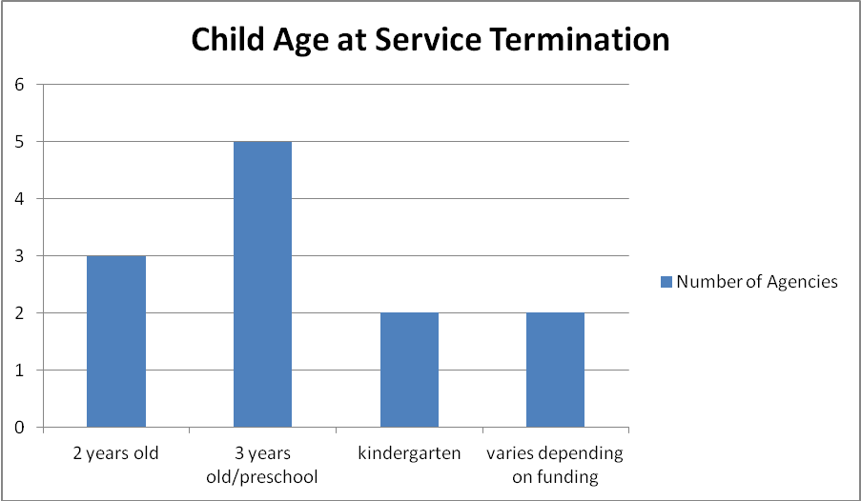
Home Visiting-Kansas City
Notes:
The variable funding sources also stipulate that home visiting agencies serve different ages of children. Currently, there is significant variability in how long a home visiting agency will serve a family based on the HVA. This too is often driven by variable funding sources.

Slide 7
Results of Strategic Plan: Goals
1. Continuous funding necessary to serve the families appropriate for home visiting services
2. A centralized recruitment, initial intake, and referral system to ensure eligible families are served by the most appropriate home visiting program to meet their identified needs
3. A coordinated approach with home visiting partners, health care, mental health, social service, and education systems in the delivery of home visiting services.
4. A data system for measurement of ongoing effectiveness of services provided and to identify areas for program improvement
5. Home visiting agencies that operate according to federally-identified “evidence-based” models, or are in the process of becoming an “evidence based” model, with standardized data collection on shared outcomes, standards, and quality measures
6. Home visiting agencies that are staffed by highly-qualified and committed personnel to provide centralized functions and services
7. Home visiting services that are culturally responsive and meet the needs of the diverse, ever-changing populations represented in the defined geographical area

Slide 8

Promise 1000
Targets the first 1000 days of life
Aims to:
  Provide stable funding
  Expand services to all children
  Include Home Visiting in Health Care
  Create a shared centralized scheduling service (CRIS)
  Create a central data intake and processing service
  Create shared quality and outcomes measures
  Improve research on outcomes and curricula

Slide 9
Centralized Scheduling
www.promise1000.org

Slide 10

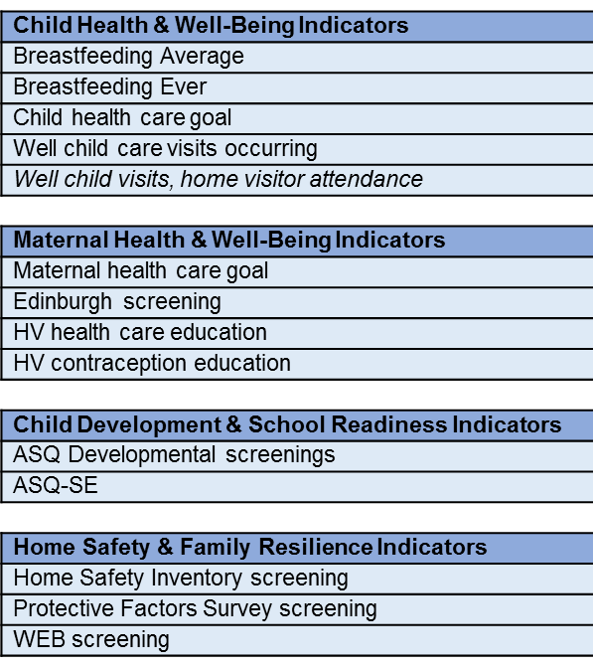
Promise 1000 Four Focus Areas

Slide 11
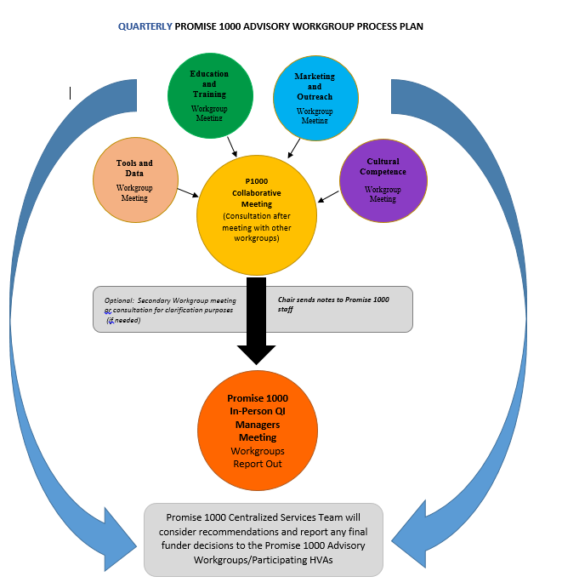

Slide 12
Current Initiatives/RFP 2018
Home Visiting and Culture
  Collaboration with CMH Office of Equity and Diversity
Birth spacing (Contraception)
Prevention of Pre-term Birth
- Collaboration with Fetal Health Center
Violence
  ACT Raising Safe Kids (Positive Parenting Program)
Home Safety/Injury Prevention (Infant Mortality)
Developmental Screening
*In addition to continued focus from 2017

Slide 13
5/1/17-1/11/18 QI Measures

Slide 14
Measure | September/October 2018 | November/December 2018
Child Health & Well-Being Indicators
Breast Feeding Avg. (Goal-6 months, 0 days) | 8 mo, 8 days
Breast Feeding % (Goal-50%) | 60%
Child Healthcare Goal (Goal-75%) | 88.05%
Well Child Visits (Goal-50%) | 48.54%
Home Visitor Attendance (Goal-50%) | 25.12%
Maternal Health & Well-Being Indicators
Maternal Healthcare Goal (Goal-70%) | 80.15%
Edinburgh Screens (Goal-70%) | 73.58%
HV Healthcare Education (Goal-70%) | 78.44%
HV Contraception Education (Goal-60%) | 81.46%
Child Development/School Readiness Indicators
ASQ 3 Screen Rate (Goal-50%) | 71.55%
ASQ SE Screen Rate (Goal-50%) | 73.5%
Home Safety & Family Resilience Indicators
Home Safety Screens (Goal-70%)* | 82.19%
Protective Factors Screens (Goal-70%) | 84.34%
WEB Screens (Goal-70%)* | 76.27%
8 mo, 13 days
61.61%
87.2%
46.68%
22.75%
81.08%
71.11%
84.59%
84.31%
73.85%
75.7%
73.85%
92.68%
75.28%
Notes:
All I have to say is “Wow”, look at the PFS scores for November/December. Many of you were at 100% screening rates for PFS, the last two quarterly comparisons there have been an 8% increase, and for Nov/Dec. it is at an outstanding 92.68%. Congratulations on all your hard work, your efforts are showing! As for the comparison between Sept/Oct and Nov/Dec - 12/14 or 86% of our indicators are in the blue or meeting our goals with well child visits still in yellow. However, the family attendance at well child visits is really close to moving to blue. We had a few measures that had very miniscule drops, and some inched up in percentage, but that can be expected as our numbers get higher and higher in percentages. The HV providing healthcare education went up by 6.15% which is great. But most notably, is how our percentages continue to grow well beyond our listed goals. Many of them are in the 70’s and 80’s with some closing in on, or exceeding, 90%, which is super impressive, and an awesome achievement. Keep up the good quality work!

Slide 15
Promise 1000 Progress Framework
Conceptualization and Groundwork
ECS
Strategic Planning
Database development
Launch
Initial grants
Growth and Improvement
Increased funding/families served
Program Improvements
Innovations and leadership
Research
Key Partnerships
Regional/national leadership
Improved Family/Child/Community Outcomes
Child Health and Well-Being
Maternal Health and Well-Being
Child Development and School Readiness
Home Safety and Family Resiliency

Slide 16
Future Plans
Expand services to reach more families in need
Further develop integration of home visiting with medical home
Dynamically target home visiting components for families based on individual needs
Progress towards a complete umbrella funding structure
Demonstrate fiscal impact on healthcare expenditures

