Slide 1
Strengthening a Community Through Evidence-Based Home Visitation
January 18, 2019
Dr. Sharmini V. Rogers, MBBS, MPH
Administrator, Section for Healthy Families and Youth
Missouri Department of Health and Senior Services

Slide 2
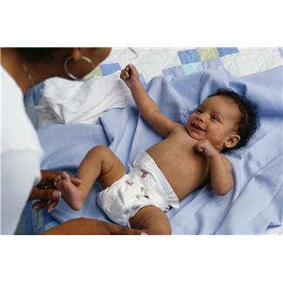
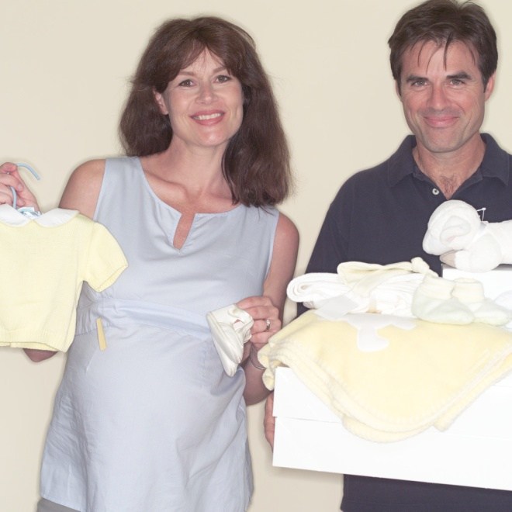
By Working Together We Can Accomplish Great Outcomes for Our Most Vulnerable Populations

Slide 3
Presentation Goals
Overview of purpose and funding of the Missouri Department of Health and Senior Services’ Home Visiting (HV) Programs
Location of programs
Home Visiting Evidence-Based Models
Data collection
Key outcomes
Continuous Quality Improvement

Slide 4
Purpose of the Program
To deliver high quality, evidence-based, voluntary early childhood home visitation services to ensure that children have the opportunity to grow up healthy, safe, ready to learn, and able to become productive members of society.

Slide 5
Definition of Services
Primary Service is Home Visiting
Offered on a voluntary basis to pregnant women or families with children birth to age five
Integrated into a comprehensive, high-quality early childhood system that promotes maternal, infant, and early childhood health, safety, development, strong parenting skills, and parent-child relationships

Slide 6
Funding
Two types of federal funding, both funded by the Department of Health and Human Services (DHHS), Health Resources and Services Administration (HRSA)
$1,244,225 Maternal and Child Health Block Grant, Title V (MCH)
$2,686,928 Maternal, Infant and Early Childhood Home Visiting (MIECHV)

Slide 7
MCH
1997- promising approach
Implemented an evidence-based program in 1999 using the Nurse Family Partnership model
Replaced promising approach to an evidence based model, Healthy Families America in 2014
Title V requires a 5 year needs assessment

Slide 10
MIECHV
Began implementation 2010 through a HRSA grant
Conducted a needs assessment
To identify communities with concentrations in the following areas:
Premature birth, low-birth weight infants, and infant mortality, including infant death due to neglect, or other indicators of at-risk prenatal, maternal, newborn, or child health
Poverty and crime
Domestic violence
High rates of high-school dropouts
Substance abuse
Unemployment
Child maltreatment

Slide 11
Top Ten At-Risk Counties Based on Composite Ranking of 13 Indicators
County | Composite ranking based on 13 indicators
Pemiscot | 1
Dunklin | 2
Butler | 3
Ripley | 4
St. Louis City | 5
Mississippi | 6
New Madrid | 7
Washington | 8
Crawford | 9
Scott | 10

Slide 13
DHSS Evidence-Based HV Models in Missouri
Early Head Start – Home-Based Option
Nurse Family Partnership
Parents as Teachers
Healthy Families America

Slide 14
Selection of Eligible Participants
Low income
Pregnant women < age 21
Child abuse/neglect
Substance abuse
Users of tobacco products
Children with low student achievement
Children with developmental delays/disabilities
Family members in armed forces

Slide 15
Integrated Data System
Web-based data system
Track standardized performance measures
Linkages to birth certificates
Linkage to DSS child maltreatment data
Maintain continuous quality improvement

Slide 16
Performance Measures
Measure 01: Preterm Birth
Measure 02: Breastfeeding
Measure 03: Depression Screening
Measure 04: Well-Child Visits
Measure 05: Postpartum Care
Measure 06: Tobacco Cessation Referrals
Measure 07: Safe Sleep
Measure 08: Child Injury
Measure 09: Child Maltreatment

Slide 17
Performance Measures
Measure 10: Parent-Child Interaction
Measure 11: Early Language and Literacy Activities
Measure 12: Developmental Screening
Measure 13: Behavioral Concerns
Measure 14: Intimate Partner Violence Screening
Measure 15: Primary Caregiver Education
Measure 16: Continuity of Insurance Coverage
Measure 17: Completed Depression Referrals
Measure 18: Completed Developmental Referrals
Measure 19: Intimate Partner Violence Referrals

Slide 18
Selected Outcome Measures

Slide 19
Selected Outcome Measures

Slide 20
Selected Outcome Measures

Slide 21
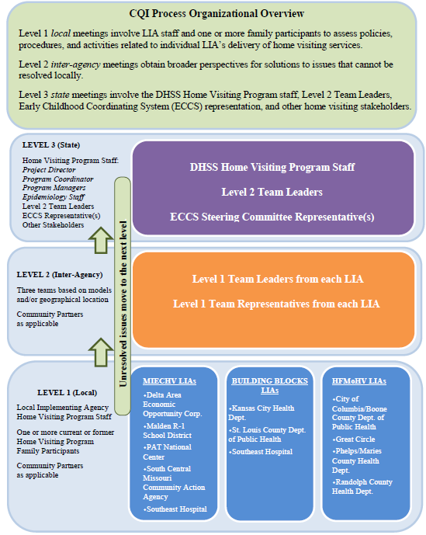
Continuous Quality Improvement

Slide 22
Contact Information
Sharmini Rogers
Administrator, Section for Healthy Families and Youth, Department of Health and Senior Services
Phone: 573.751.6149
Email: Sharmini.Rogers@health.mo.gov

Slide 23
Thank You!

