Slide 1
FY 2021 Child Sexual Abuse Prevention Grant funding Opportunity
Pre-Bid Webinar
Tuesday, August 18, 2020
Notes:
Welcome

Slide 2
About the Children’s Trust fund
The Children’s Trust Fund (CTF) is Missouri’s foundation for child abuse prevention. CTF was created by the Missouri General Assembly in 1983 for the sole purpose of preventing the abuse and neglect of children.

Slide 3
About CTF’s Child Sexual Abuse Prevention Grant Opportunity
Up to $2 million allocated over 48 months
Priority on creating a culture of protection and prevention
First time release of funds solely targeting the prevention of child sexual abuse
Preventing child sexual abuse is a CTF strategic priority

Slide 4
Priorities
Eligible communities
Collaboration between key community partners
Layered, multi-intervention approach
Public health approach

Slide 5
Eligible Communities
Only zip codes with high rates or high counts of child sexual abuse will be considered
Zip codes with high rates and high counts of child sexual abuse will be given special consideration
Child Sexual Abuse – 30 Highest Zip Codes by Rate and Count: https://arcg.is/1TS9Db2
Average Child Sexual Abuse Report Rates by County (2008-2018): https://arcg.is/11j1Ku0
Notes:
Eligible Communities
Proposals will only be considered for interventions targeting zip codes with high rates or counts of child sexual abuse reports. Special consideration will be given to proposals targeting zip codes with high rates and high counts of child sexual abuse reports.
Please see the following maps to determine which Missouri communities are eligible for funding.
Child Sexual Abuse – 30 Highest Zip Codes by Rate and Count:
https://arcg.is/1TS9Db2
Average Child Sexual Abuse Report Rates by County (2008-2018):
https://arcg.is/11j1Ku0
Full county efforts, or efforts extending beyond the zip codes with high rates or counts, will be considered but must be well justified.

Slide 6
A Public Health Approach
Define the problem
Develop/Implement prevention strategies
Assure widespread adoption
Identify risk and protective factors
National Center for Injury Prevention and Control, Division of Violence Prevention

Slide 7
Collaboration
Identify shared goals and co-benefits across sectors to build trust, enable partnerships and share successes
Activate the community to help frame the conversation and build community buy-in
Leverage funding, resources and willingness to partner from complementary programs to support cross-agency efforts
Engage partners early and develop relationships
Define a common language across and within sectors to help remove communication barriers
https://www.astho.org/NPS/Toolkit/Characteristics-of-Successful-Collaboration/
Notes:
Working together, sharing resources, and combining talents enhance the opportunities and increases chances for achieving anticipated outcomes. Because of the complexity of child sexual abuse, agencies and others that are involved in prevention efforts cannot be as effective working in isolation.
This table is from the Association of State and Territorial Health Officials’ National Prevention Strategy. It may be a helpful resource.

Slide 8
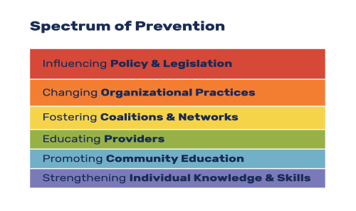
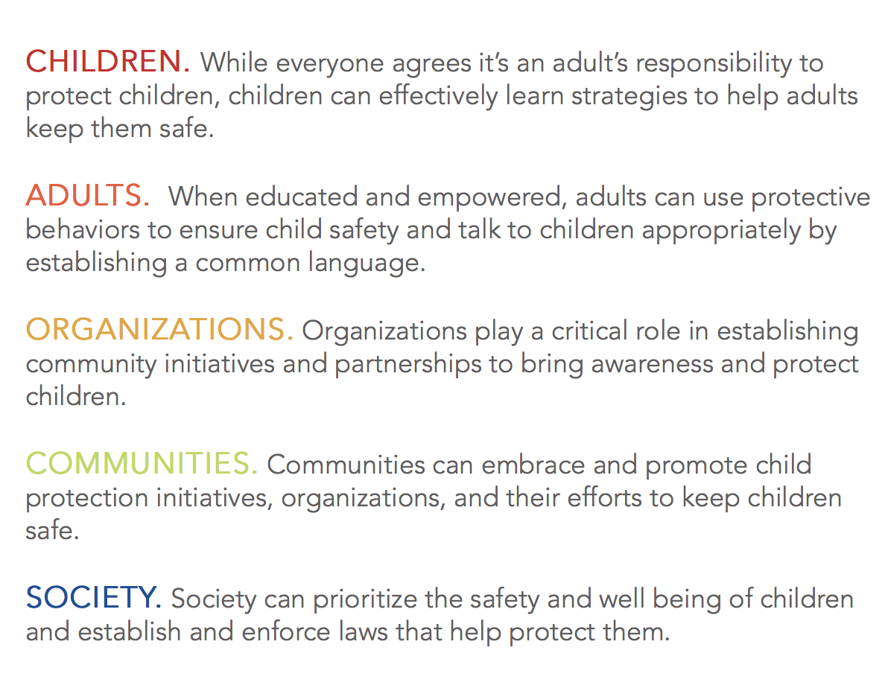
Layered, Multi-Intervention Approach
From the Prevention Institute*
Levels of Prevention (from Prevent 360)*
*https://www.preventioninstitute.org/tools/spectrum-prevention-0
*https://www.prevent360.org/about-prevent-360
Notes:
Addressing child sexual abuse effectively will require multiple strategies, especially when doing so in away that aims to have community-wide impact. The Prevention Institute’s Spectrum of Prevention illustrates the different layers that go into creating change. The Prevent 360’s Levels of Prevention illustrate those, from individual to societal levels, in a community that you will want to consider when thinking through strategies and potential interventions. Originally two different slides, I decided to put these two tables side by side as an opportunity to crosswalk between the two.
Credit: Spectrum of Prevention – The Prevention Institute (https://www.preventioninstitute.org/tools/spectrum-prevention-0)
Credit: Levels of Prevention/ Prevention 360/Monica Burr Foundation (https://www.prevent360.org/about-prevent-360)

Slide 9
Funding Cycle
Year of Grant Cycle | Contract Period | Corresponding State Fiscal Year | Amount Allocated by State Fiscal Year
Year 1 | January 1 – June 30, 2021 (6-month contract) | FY 2021 | $250,000
Year 2 | July 1, 2021 – June 30, 2022 (12-month contract extension) | FY 2022 | $500,000
Year 3 | July 1, 2022 – June 30, 2023 (12-month contract extension) | FY 2023 | $500,000
Year 4 | July 1, 2023 – June 30, 2024 (12-month contract extension) | FY 2024 | $500,000
Year 5 | July 1 – December 31, 2024 (final 6-month contract extension) | FY 2025 | $250,000
Notes:
While the actual grant cycle is 4 calendar years, because CTF is appropriated and allocates funding based on the State Fiscal Year, which runs from July 1-June, there will actually be five contract periods, with two of those being 6-months in length.

Slide 10
Application Process
Two step process
Letter of Intent (LOI) due September 15, 2020
Full applications due October 30, 2020 (by invitation only)

Slide 11
Letter of Intent (LOI) to Apply
Due by close of business on September 15, 2020. Email LOIs to ctf@oa.mo.gov
LOIs will be reviewed and invitations to submit full proposals emailed by September 30, 2020
Complete all sections of the LOI, keeping it to three pages
Notes:
Mention the review process here...panel of reviewers include CTF staff, CTF board members, and external evaluators with expertise in child sexual abuse prevention.

Slide 12
Notes:
Question 2 – please refer to the maps linked on page 1 of RFP.
Question 3 – may also want to include information on potential collaborative partners.

Slide 13
Narrative
Single spaced with font no smaller than 11
Follow the outline noted in the RFP
Separate each section with headings
Adhere to the noted page limits

Slide 14
Summary – 5 points
Limit to ½ page
Provide a brief, but concise, summary of the project for which funds are requested

Slide 15
Community or Population to be served – 20 points
Limit to 1 page
Describe the population within the targeted zip code(s) or county that will targeted by the proposed project
Include rates and number of incidences of child sexual abuse
Include characteristics of the community including those that increase child sexual abuse risk factors, as well as those that demonstrate a readiness to address child sexual abuse
Notes:
Include data that supports the need.

Slide 16
Prevention efforts & Methodology – 20 points
Describe the proposed child sexual abuse prevention efforts and the methodology for preventing child sexual abuse in the target area – describe project intentions, and how goals and anticipated outcomes are to be realized
Limit to 1.5 pages

Slide 17
Collaboration – 20 points
Limit to1 page
Identify and briefly describe the community partners who will be involved in this project, including the role they will play in the project. Please attach Memorandums of Understanding and/or Letters of Support, or other documentation

Slide 18
Organizational Mission and experience – 5 points
Limit to ¾ page
State the mission of the applicant organization. Describe any experience or accomplishments in the area of child abuse and neglect prevention, including applicant history of providing child abuse and neglect prevention services
Notes:
Priority consideration will be given to

Slide 19
Program Budget Description and Justification – 10 points
Limit to 1 page
Align with Attachment 2 (budget template). Detail the expenses requested in the budget for Year 1 only. Please include the basis for cost and an explanation of why the request is important to the implementation of the project
*While estimates for Years 2-5 are requested on Attachment 2, detail for those years are not needed for this proposal. Successful applicants will be required to submit renewal applications for each additional year of the project. Detailed budgets will be required at the time of renewal for each additional year of the project.
Notes:
*While estimates for Years 2-5 are requested on Attachment 2, detail for those years are not needed for this proposal. Successful applicants will be required to submit renewal applications for each additional year of the project. Detailed budgets will be required at the time of renewal for each additional year of the project.

Slide 20
Eligible Budget Categories
Salaries and Wages
Fringe Benefits
Contractual Services
Space Costs
Consumable Supplies
Travel
Notes:
Salaries and Wages – wages for personnel that will be working on the project for which CTF funding is being requested
Fringe Benefits –fringe benefit costs to support CTF-funded project staff
Contractual Services – must be documented with a contract detailing services to be performed and agreed upon compensation
Space Costs – space costs specific project-related staff
Consumable Supplies – Office supplies
Travel – Meals, mileage and lodging related to project specific services or project staff development (travel to approved conference). Mileage capped at 37 cents/mile (state rate).

Slide 21
Eligible Budget Categories, continued
Communications (phone/cell)
Non-consumable Supplies
Program Related Expenses
Other Costs
Notes:
Communications – costs related to landline and cell phone services
Non-consumables – equipment, furniture
Program Related Expenses – materials for working with parents/families, conference registrations
Other Costs – if awarded, annual background check fees may be requested through the grant. Administrative costs (capped at 5%).
For the sake of reporting volunteer time as match, please include that estimated value on the Other Costs line-item/Local match column

Slide 23
explanation of budget over the Grant Cycle
Year 1 – budget for 6-month contract
Years 2-4 – budgets based on 12-month contracts and award will be no more that 2 x the amount awarded in year one
Year 5 – budget for 6-month contract and award amount will be the same as in year one

Slide 24
Example
Year of Award | Award Amount
Year 1 (FY 2021) | $50,000
Year 2 (FY 2022) | $100,000
Year 3 (FY 2023) | $100,000
Year 4 (FY 2024) | $100,000
Year 5 (FY 2025) | $50,000
TOTAL for the Cycle | $400,000
Notes:
Example, a grant is awarded in year one for $50,000 for a six-month contract. Grantee’s maximum amount available for years 2-4 (12-month contracts) is $100,000 each year. The fifth year will be a six-month contract and the award amount $50,000 in this example (same as for the first year).

Slide 25
Action plan – 20 points
Must use the logic model template (Attachment 2)
Detail the goal(s), objectives, anticipated outcomes, activities and timeline for the proposed project, as well as what evaluation* tools or data collection tools will be used to assess the project.
*All applicants awarded a grant will be required to work with CTF’s program evaluator

Slide 27
Action Plan
Goals are broad – the intention of the project
Objectives are concrete, measurable and time bound*
Outcomes are changes in knowledge, behavior, attitudes or conditions of the target population that will help prevent child sexual abuse. An outcome is what changes for the people or community served by a project or program. What are the anticipated outcomes of the project? What will be different or change as a result of the project?
Prevention Activities – What will you be doing?
Outputs – How many individuals will be impacted/served by the proposed program (# of individuals trained, # of collaborative partners, for example)?
Notes:
*Objectives may be process oriented – for example, revising an agencies policies and procedures as they relate to preventing child sexual abuse.

Slide 28
Action plan, continued
Target population – Who do you anticipate serving (community members, staff, youth, etc.)
Responsible Staff – Who will be responsible for the prevention activity?
Timeline – When will project implementation/activities take place in time?
Evaluation Tools/Data Collection Method – Describe the measurement or assessment tools that will be used to collect data and evaluate the impact of project activities.
Notes:
The tools you propose to use to evaluate the success of project must measure data related to the anticipated outcomes.

Slide 29
Evaluation
In addition to tracking specific to individual Action Plans, grantees will be required to work with CTF’s evaluator.
CTF’s evaluator will work with each community awarded a grant to provide guidance on developing/refining an evaluation plan that provides CTF needed information, and is also a resource for communities to develop evaluation plans with value beyond grant compliance.

Slide 30
Required Documents
Original Cover Letter and LOI will serve as application cover pages
IRS 501 (c)(3) certification letter if applicable
Program Budget (must use CTF budget template – Attachment 2)
Most recently audited financials (if applicable) or most recently completed financial statement for the organization
Applicant’s current year’s operating budget, including income and expenses
Current list of the applicant organization’s Board of Directors and their affiliations
Assurances/Certification signature page (Attachment 3)

Slide 32
Grant Requirements
Background Checks – Initial Family Safety Care Registry (FCSR) and state and national criminal background checks are required. FCSR is required annually. Specifics are detailed in the RFA.
Monitoring and Program Reporting – Site visits, progress reports and annual reporting.
Compliance Meeting – Successful applicants will be required to attend a compliance meeting in January 2021.
Notes:
If awarded…more detail and instruction will be included in the award notification and compliance meeting for successful applicants.
Site visits: In person or virtual. Purpose is to discuss program progress, as well as review of documentation related to expenditures.
Progress reports: Required as part of renewal application process.
Annual reports: Due July 31 for the preceding fiscal year.
Compliance meeting – will be virtual

Slide 33
Important Deadlines
Letters of Intent (LOI) to apply are due by close of business on Tuesday, September 15, 2020. Please submit LOIs to ctf@oa.mo.gov.
For applicants invited to submit a full proposal, full proposals are due Friday, October 30, 2020. Please submit full proposals to ctf@oa.mo.gov.

Slide 34
When Submitting the Letter of Intent and Application…
Applicants MUST use the forms provided by the Children’s Trust Fund.
Letter of Intent to apply and (if invited) full proposals must be emailed to ctf@oa.mo.gov.

Slide 35
Contractual Agreement and Contract Period
If approved, an Award of Contract will serve as the contractual agreement between CTF and the applicant.
The contract period for approved projects is:
January 1, 2021
through
June 30, 2021

Slide 36
Obtaining the CTF CSA Prevention Application
The CSA Prevention Application is available at:
www.ctf4kids.org
or
ctf@oa.mo.gov
Notes:
Website > Funded Programs main tab: Funding Opportunities

Slide 37
Contact Information
Laura K. Malzner, Program Director
laura.malzner@oa.mo.gov
573-751-6511
ctf4kids.org

Slide 38
Questions? Thank you

