Slide 1









Missouri Home Visiting Referral System
CRIS Link

Slide 2

Missouri Home Visiting Referral System
Missouri Home Visiting Referral System
The Missouri Home Visiting Referral System is a web-based platform that makes it easy to refer a family to home visiting services anywhere in the state through one of five Regional Coordinated Referral & Intake System (CRIS) networks. Each regional CRIS network is managed by a state-funded home visiting collective impact site and includes a variety of home visiting programs and models in its specific service area.
ctf4kids.org/cris-start-a-referral

Slide 3
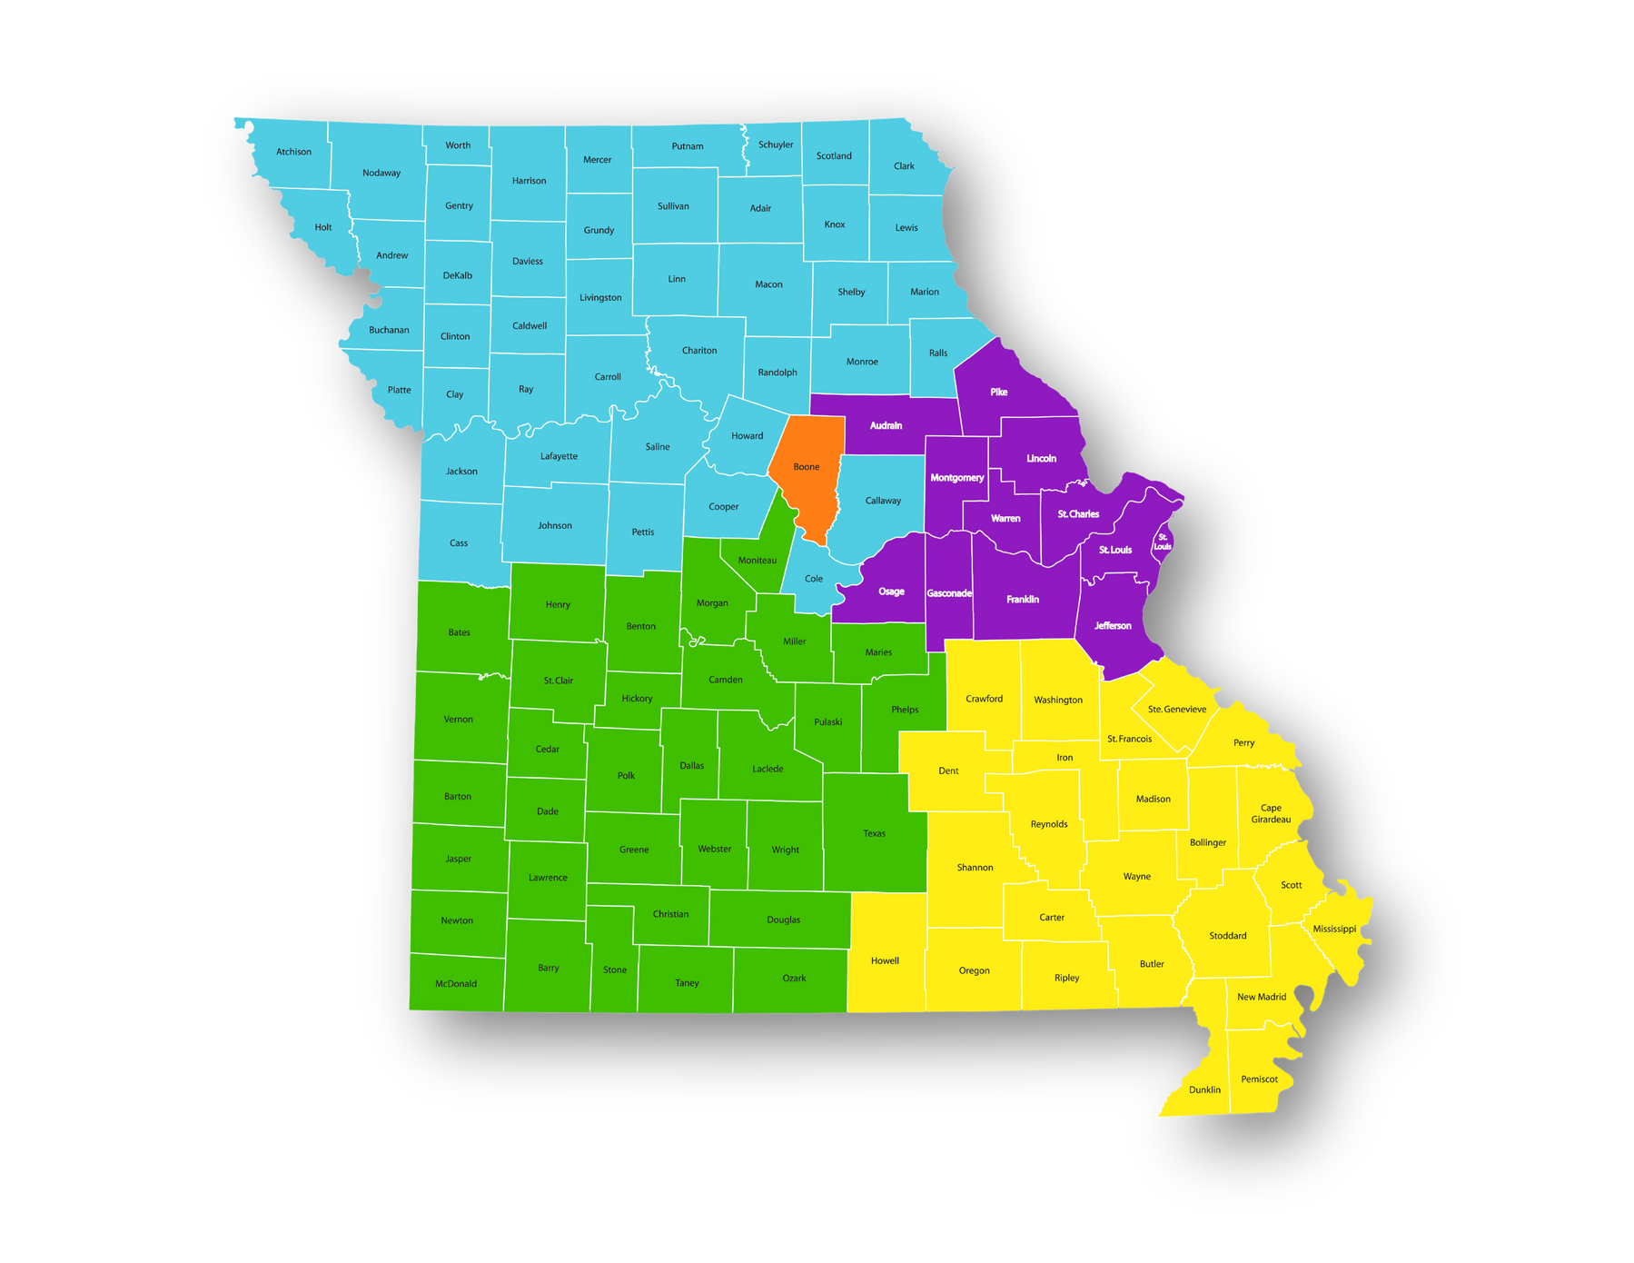
Missouri Home Visiting Referral System
What is the
CRIS Link?
The CRIS Link is FREE & EASY for anyone to use.
The CRIS Link is the connector of the home visiting referral system. It is a one-stop shop for anyone in Missouri who wants to make a referral for home visiting services (prenatal to five). The CRIS Link connects users to one of five regional referral networks — called a Coordinated Referral & Intake System (CRIS) — to submit a referral based on their location.
Each CRIS network is led by a collective impact site that manages the collaborative efforts of participating home visiting programs and models within its region.
Region
CRIS Coordinator
1
Brighter Beginnings
2
Generate Health
3
Family Focused Network
4
Promise 1000
5
Whole Kids Outreach
ctf4kids.org/cris-start-a-referral

Slide 4
Missouri Home Visiting Referral System
What is the
CRIS Link?
Region/Coverage
Collective Impact Site
1
Brighter Beginnings
2
Generate Health
3
Family Focused Network
4
Promise 1000
5
Whole Kids Outreach
ctf4kids.org/cris-start-a-referral

Slide 5


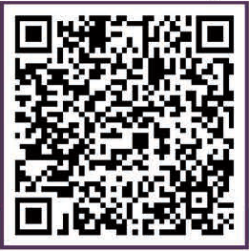
Missouri Home Visiting Referral System
What is a regional CRIS?
Each CRIS network (or ‘Regional CRIS’) is led by a collective impact site that manages the collaborative efforts of participating home visiting programs and models within its region.
Each Regional CRIS consists of various home visiting programs and models within its network (including but not limited to Early Head Start, Healthy Families America, Nurse Family Partnership, Parents as Teachers, and more).
With a number of programs available within each CRIS, families can access services based on their needs, eligibility and location. Best of all — CRIS can determine the best placement so you don’t have to.
Learn more or
start a referral
ctf4kids.org/cris-start-a-referral

Slide 6






Missouri Home Visiting Referral System
Why CRIS?
  It’s FREE & EASY to use
  Easy to turn off referrals to manage capacity
  Matches families with programs that best meet their needs & location
  Can supplemental other referral sources
  No need to remember:
    Coverage areas
    Eligibility criteria
    Capacity to serve
Learn more or
start a referral
ctf4kids.org/cris-start-a-referral

Slide 7
Missouri Home Visiting Referral System
How does CRIS work?
Anyone can make a referral using the CRIS Link:
  Go to ctf4kids.org/cris-start-a-referral
  Select the family’s county to find the CRIS Network in their region
  Click to “Begin Here”
  Submit an online form through the Regional CRIS Network’s referral page
Once the referral is submitted, the Regional CRIS assigns the family to a home visiting program based on the family’s needs and eligibility, and the program’s capacity.
The assigned home visiting agency then contacts the family to tell them more about their program and offer services.
To learn more or start a referral, contact your CRIS Coordinator
ctf4kids.org/cris-start-a-referral

Slide 8
Consider joining your
Regional CRIS Network

Slide 9
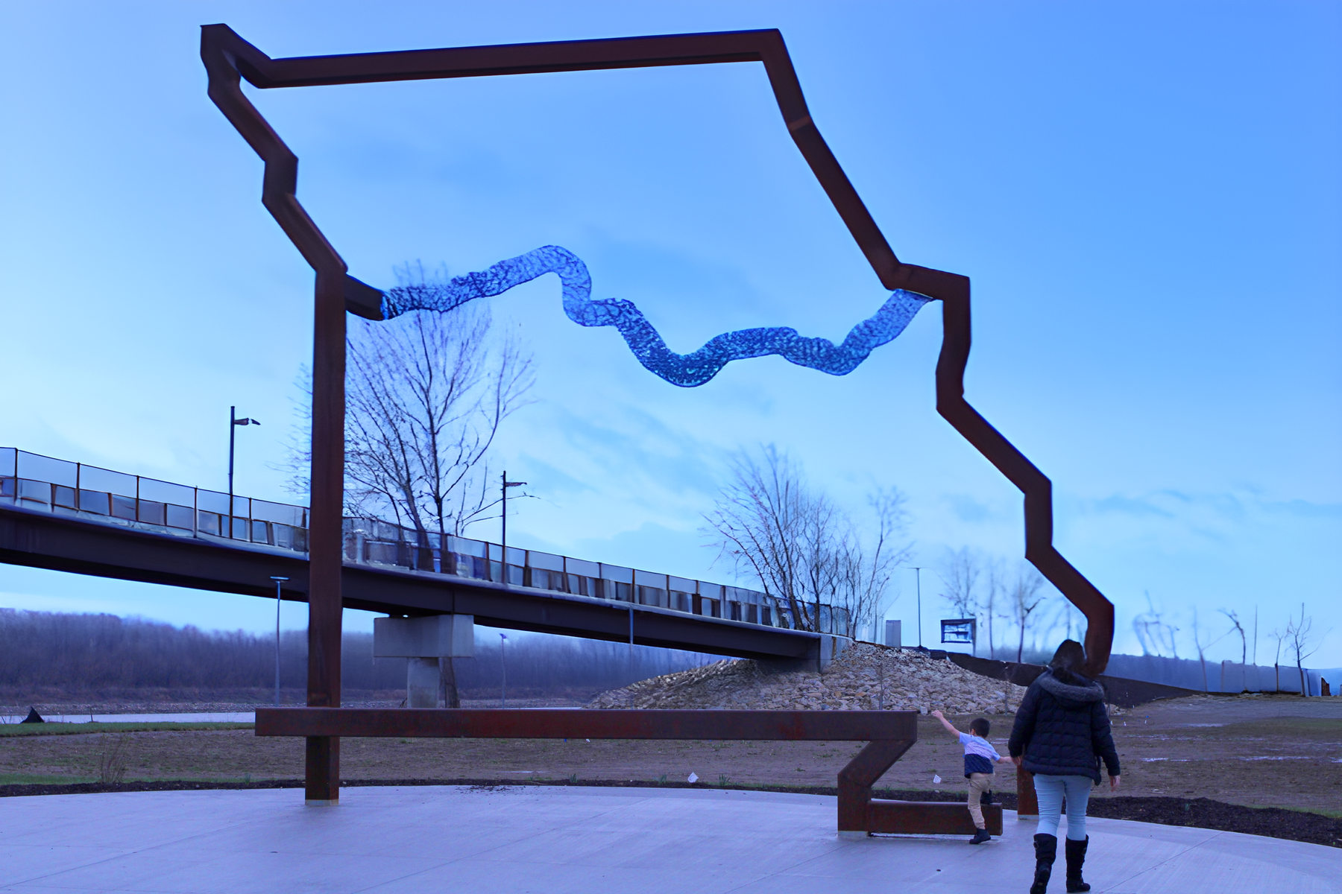
Missouri Home Visiting Referral System
When you join your
regional CRIS. . .
You join a collaborative network of home visiting partners with a common goal of making home visiting accessible to anyone who needs it.
Easily receive & manage referrals
Free up time to focus on families
Ensure families find a place to land
Learn more or
start a referral
ctf4kids.org/cris-start-a-referral

Slide 10

Missouri Home Visiting Referral System
What about my other referral partners?
Joining and using the CRIS does not exclude you from working with other referral partners. If you have relationships and agreements with other referral networks, you can maintain these while also incorporating your CRIS Network as needed.
Learn more or
start a referral
ctf4kids.org/cris-start-a-referral

Slide 11

Missouri Home Visiting Referral System
What if my agency reaches capacity?
The software that runs this adaptive referral system is smart and efficient. Participating home visiting providers are able to connect with their regional Collective Impact (CI) site when they are at capacity (or are unable to take referrals during a period of time).
The CI site monitors and maintains CRIS and can easily turn off referrals to manage capacity and turn them back on when you’re ready.
Learn more or
start a referral
ctf4kids.org/cris-start-a-referral

Slide 12

Missouri Home Visiting Referral System
Is there any training involved?
If you or your team needs help learning how to navigate CRIS or wants to learn more about the other opportunities through the collective impact site in your region, your Regional Collective Impact Site Coordinator can help.
CRIS allows the CI site to track, organize and report out aggregate referral data and they can provide you with your own referral data that matters to you.
Learn more or
start a referral
ctf4kids.org/cris-start-a-referral

Slide 13

Missouri Home Visiting Referral System
How do I join?
Join our growing network of home visiting providers across Missouri. Visit ctf4kids.org/cris-start-a-referral to be linked to the Regional Collective Impact Coordinator in your area.
You can also scan the QR code to be taken directly to the CRIS Link.
Learn more or
start a referral
ctf4kids.org/cris-start-a-referral

Slide 14
Missouri Home Visiting Referral System
Thank you!
Questions?
I’d love to hear from you!
email
Learn more or
start a referral
ctf4kids.org/cris-start-a-referral

