Slide 1

MIECHV Expansion Informational Meeting
Notes:
https://docs.google.com/spreadsheets/d/160SijudJr-bUuSXeLMReGSzK2zOaHX65YGY4s5eUDFU/edit?usp=sharing

Slide 2
What is MIECHV?
Maternal Infant Early Childhood Home Visiting (MIECHV)
Authorized by the Affordable Care Act (2010), it is administered by the Health Resources and Services Administration (HRSA) in partnership with the Administration for Children and Families (ACF)
The program helps pregnant women and parents of young children achieve positive health outcomes, improve child development, and strengthen family economic self-sufficiency.
CTF is the state intermediary of the funds
Notes:
federally funded home visiting program, located in targeted counties based on a required needs assessment. These programs prioritize services to communities and families most at risk for poor maternal, infant, and child health outcomes.
Purpose: To support positive health outcomes, improve child development, and strengthen family economic self-sufficiency. The MIECHV Program helps pregnant women and parents of young children improve health and well-being for themselves and their families. The Program does this by partnering trained home visitors with families to set and achieve goals.
Target Population: Families living in communities with high risk factors, including poverty, low educational attainment, or high rates of crime/substance abuse.
Services Provided: Home visitors offer education on prenatal care, breastfeeding, safe sleep, positive parenting techniques, child development, and connections to community resources.
Funding & Administration: Authorized by the Affordable Care Act (2010), it is administered by the Health Resources and Services Administration (HRSA) in partnership with the Administration for Children and Families (ACF).
MIECHV funds specific, evidence-based models, including – NFP, HFA, EHS-HBO, PAT

Slide 3
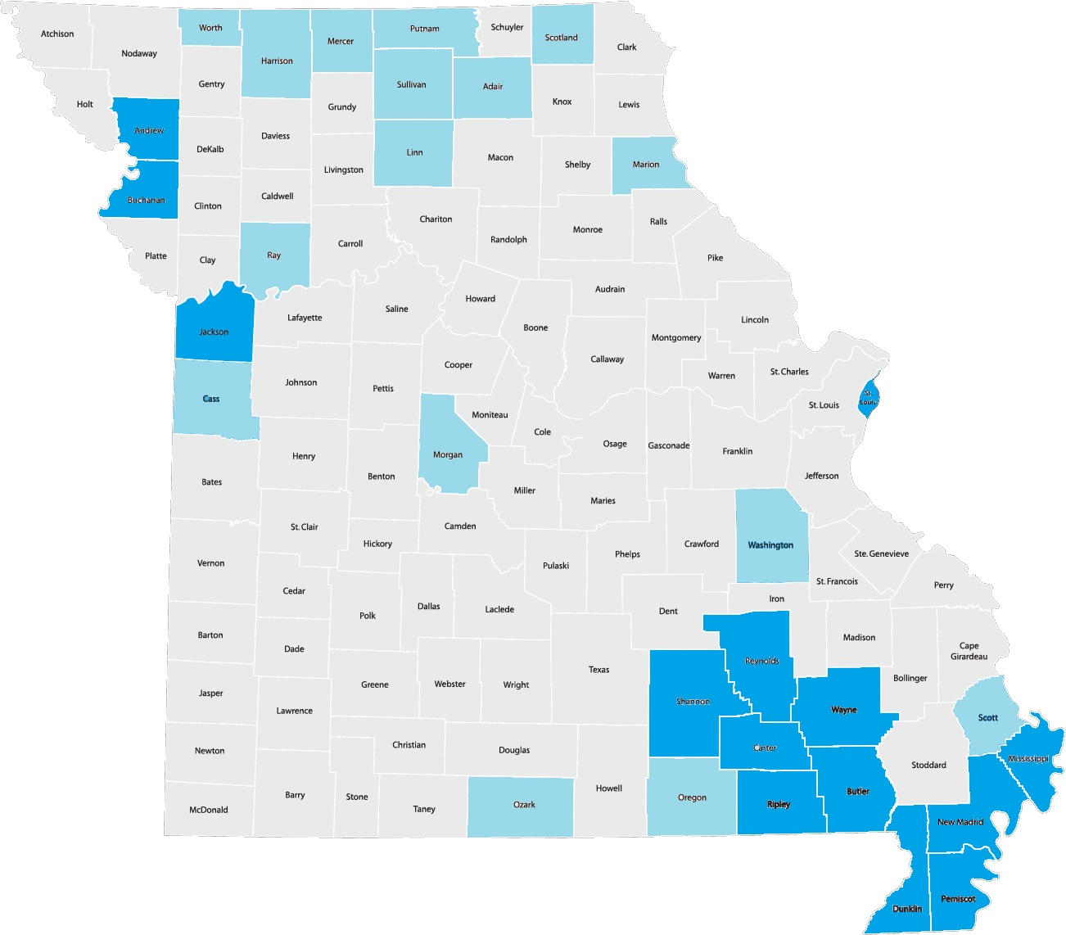
MIECHV Eligible Counties
Counties identified by the Missouri 2020 MIECHV Needs Assessment
*MIECHV is currently in 14 counties with 7 local implementing agencies. (Visit https://ctf4kids.org/home-visiting-programs/miechv/ for more information)
Notes:
A total of 30 counties were identified as MIECHV eligible following the Missouri 2020 MIECHV Needs Assessment. Of these 30 counties, 14 currently receive MIECHV funding. Assessments addressed eleven (11) indicators of risk specified in initial and subsequent MIECHV Program guidance, which supports the development of home visiting programs in communities with high rates of premature birth, low birth weight infants, infant mortality, and other health indicators such as poverty, crime, domestic violence, low educational attainment, substance use, unemployment, and child maltreatment.

Slide 4
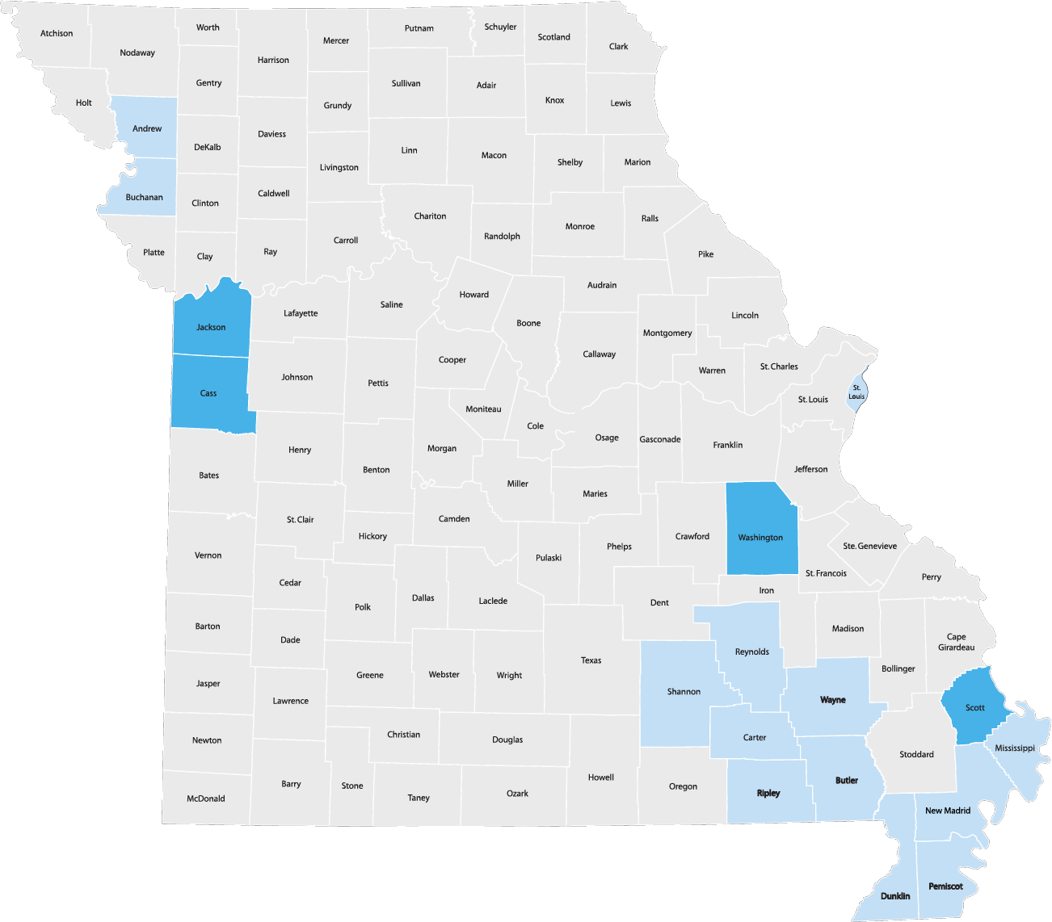
Purpose for Funding
To release $800,000 in Maternal, Infant and Early Childhood Home Visiting (MIECHV) funding to establish and/or expand evidence-based home visiting services within the counties of Cass, Jackson, Scott and Washington
CTF will consider one or more 1-year contracts with no limit on what eligible applicants may request. Awarded grantees will be given the option to renew their contracts in FY28 for a total of three additional renewal periods based on performance and availability of funding.
Notes:
CTF is targeting the counties of Cass, Jackson, Scott and Washington because, of the 30 counties identified in the most recent needs assessment, these counties have the highest number of young children living in poverty in comparison to little to no amount of MIECHV funding in the county. By placing heavy emphasis on serving families in high-poverty areas, CTF seeks to broaden the impact of home visiting services in Missouri by reaching families in the greatest need of community support.
CTF will consider 1-year contracts with awarded grantees given the option to renew their contracts in FY28. Initial contracts will have a term of one year. Grantees will have the option to renew their contracts in FY28, subject to performance and funding availability. Grantees will be eligible for up to three 1-year renewals. Award amounts are based on need and funds available, and therefore subject to change from year to year.

Slide 5
MIECHV Legislative Requirements
Improvements in prenatal, maternal, and newborn health, including improved pregnancy outcomes;
Improvements in child health and development, including the prevention of child injuries and maltreatment and improvements in cognitive, language, social-emotional, and physical development indicators;
Improvements in parenting skills;
Improvements in school readiness and child academic achievement;
Reductions in crime or domestic violence;
Improvements in family economic self-sufficiency; and
Improvements in the coordination of referrals for, and the provision of, other community resources and support for eligible families, consistent with child welfare agency training.
Notes:
Key outcomes include the prevention of child maltreatment and positive impacts in the areas of child and maternal health, child development and school readiness, parent/child interactions, and family economic self-sufficiency.

Slide 6
Eligibility to Apply
Must be an established and operational home visiting provider with experience providing early childhood home visiting services.
Utilizes a HomVEE, MIECHV-approved evidence-based home visiting model and can demonstrate fidelity to the model;
Delivers year-round services, with a minimum of 1-2 visits per month;
Ensure home visiting staff are trained in the model and topics required by the model;
Current MIECHV local implementing agencies are also eligible to apply.
Notes:
To be considered for this funding applicants must: (outlined above)

Slide 7
Eligibility to Apply – Cont.
Be a CRIS Referral Partner (Coordinated Referral & Intake System) through a regional Home Visiting Collective Impact (CI) site & communicate with CI site to learn more about community meetings and how to participate;
Participate in professional development training and quality improvement activities as required by CTF;
Participate fully in the MIECHV three-tiered continuous quality improvement (CQI) process;
Implement the MIECHV family satisfaction survey annually with enrolled clients;
Ensure services are provided in a manner that is sensitive to cultural, ethnic, religious, and diversity issues, including appropriateness of presentations provided by personnel and program materials;
Notes:
Further successful applicants will: Already be part of or be willing to become a CRIS Referral Partner (Coordinated Referral & Intake System) through a regional Home Visiting Collective Impact (CI) site, See CRIS Start a Referral | Children's Trust Fund of Missouri;
Communicate with their regional Collective Impact (CI) site to learn more about community meetings and how to participate;
Participate in professional development training and quality improvement activities as required by CTF;
Participate fully in the MIECHV three-tiered continuous quality improvement (CQI) process, including Level 1 (Local team meeting), Level 2 (inter-agency) and Level 3 (state level). See CQI attachment;
Implement the MIECHV family satisfaction survey annually with enrolled clients as provided and coordinated by CTF;
Ensure services are provided in a manner that is sensitive to cultural, ethnic, religious, and diversity issues, including appropriateness of presentations provided by personnel and program materials;

Slide 8
Eligibility to Apply – Cont.
Within 60 calendar days of contract issuance, ensure any new hires are onboarded or scheduled, begin marketing with potential home visiting referral partners and start recruiting families;
Within 180 calendar days of contract issuance, the contractor will provide home visiting services to families to be at or near full implementation caseload capacity based on the implemented home visiting model and best practice standards;
Coordinate services to ensure the complex and diverse needs of the identified at‐risk communities are being met and fulfill the grant requirements outlined in HRSA guidelines;
Implement program services with fidelity to the home visiting model and will adhere to policies, procedures, and data collection requirements set forth by CTF; and
Be trained in and utilize a CTF-approved REDCap database to record core data collection, including MIECHV performance measures, demographics and forms.
Notes:
Within 60 calendar days of contract issuance, ensure any new hires are onboarded or scheduled, begin marketing with potential home visiting referral partners and start recruiting families;
Within 180 calendar days of contract issuance, the contractor will provide home visiting services to families to be at or near full implementation caseload capacity based on the implemented home visiting model and best practice standards;
Coordinate services to ensure the complex and diverse needs of the identified at‐risk communities are being met; and fulfill the grant requirements outlined in HRSA guidelines;
Implement program services with fidelity to the home visiting model and will adhere to policies, procedures, and data collection requirements set forth by CTF; and
Be trained in and utilize a CTF-approved REDCap database to record core data collection, including MIECHV performance measures, demographics and forms.

Slide 9

Family Participation Requirements
Legislative requirements define eligible families for MIECHV services as:
A woman who is pregnant and the father of the child, if the father is available; or
A parent or primary caregiver (PCG) of a child, including grandparents or other relatives of the child, and foster parents, who are serving as the child’s PCG from birth to kindergarten entry, and including a noncustodial parent who has an ongoing relationship with, and at times provides physical care for the child.
Notes:
With this funding, awarded grantees will be required to provide evidence-based home-visiting services to eligible families as defined by MIECHV legislative requirements. The home visiting provider will ensure that participation of each eligible individual/family in the program is voluntary and that services are provided to eligible individuals/families in accordance with an individual assessment(s) to identify specific needs. MIECHV legislative requirements define eligible families as:

Slide 10
Family Participation Requirements
Eligible families who reside in the counties identified for expansion opportunity (Cass, Jackson, Scott or Washington)
Low-income eligible families;
Eligible families who are pregnant women who have not attained age twenty-one (21);
Eligible families that have a history of child abuse or neglect or have had interactions with child welfare services;
Eligible families that have a history of substance abuse or need substance abuse treatment;
Notes:
Per legislation priority for services through MIECHV funding includes the following: low-income (185% federal poverty level or below); pregnant women who are less than 21 years of age; history of interaction with child welfare services; history of substance misuse;

Slide 11
Family Participation Requirements
Eligible families that have users of tobacco products in the home;
Eligible families where the PCG or children currently residing in the home have experienced, or are currently experiencing, low student achievement;
Eligible families with children with developmental delays or disabilities; and
Eligible families or individuals that are serving or formerly served in the Armed Forces, including such families that have members of the Armed Forces who have had multiple deployments outside of the United States.
Notes:
use of tobacco or tobacco products in the home; primary caregivers and/or children who have had low student achievement; families with children who have developmental delays or disabilities; primary caregivers who have or are serving in the armed forces.

Slide 12
Use of Funds
Staff time and travel expenses related to administering and/or providing home visiting services;
Model costs;
Information technology hardware, software, and technical support related to administering, providing, and/or participating in home visiting services;
Marketing and outreach to facilitate access to home visiting services;
Professional development activities and trainings;
Continuous quality improvement activities;
Incentives that are reasonable and justifiable for participating families, including developmentally appropriate toys and/or books, safety or hygiene-related items, transportation assistance, grocery cards or gift cards to baby/child stores (excluding phone cards), specific basic family needs, etc.
Indirect costs necessary to the performance of the project, not to exceed 10% (15% if approved federal NICRA) of the total contract amount.
Notes:
Awarded funds may only be used for expenses related to home visiting service activities. Eligible expenses include, but are not limited to: (listed above)
Incentives: Must monitor the use of gift cards to include approval processes, logging, family acknowledgments and attempts to ensure restrictions on the purchase of tobacco, alcohol or firearms. (gift card restrictions)
To purchase and provide supplies, programs must first ensure supplies cannot be accessed elsewhere in the community or through other family support programming.
Awarded grantees will invoice CTF monthly (by the 15th of the following month of expenses) for reimbursement of approved expenses that have been incurred by the grantee.
Indirect is 10% unless site has a higher Negotiated Indirect Cost Rate Agreement (NICRA) with the federal government

Slide 13
Award and Grant Requirements
Contracting and Payment – Invoices are due to CTF by the 15th of the month following the month in which the expenses are incurred. Payment will be made in arrears within ninety days of CTF’s receipt of an invoice. Payment is conditional upon CTF’s approval of an invoice and funds being available to CTF.
Flex Spending – Grantees can flex up to 10% of their total award between already approved line items/expenses. If additional flex or a new budget request is needed, a budget amendment can be issued through the last quarter of the funding year.
Payment – Grantees must be registered as a vendor with the State of Missouri through the MissouriBUYS eProcurement System. Additionally, all CTF grantees must participate in the E-Verify program, have no taxes due to the State of Missouri, and be in good standing with the federal government.
Notes:
CTF will provide invoice template and agency will invoice CTF monthly for reimbursement of approved expenses incurred. Invoices are due to CTF by the fifteenth (15th) day of the month following the month in which the expenses are incurred. Payment is conditional upon CTF’s approval of an invoice and funds being available to CTF.
Flex spending - Grantees can flex up to 10% of their total award between approved line items and expenses. If additional flex or a new budget request is needed, a budget amendment can be issued through the last quarter of the funding year. With 10% flex spending, the CTF provided invoice will not change. CTF will provide a new updated invoice following a formal budget amendment only.
Additionally, all CTF grantees must participate in the E-Verify program, have no taxes due to the State of Missouri, and be in good standing with the federal government.

Slide 14
Award and Grant Requirements
The contractor must ensure that all employees and volunteers, having direct contact with children younger than eighteen years of age through their CTF-funded program complete required background checks.
Requirements Include:
Register with the Family Care Safety Registry (FCSR) and provide FCSR screening results to the employer. FCSR screenings must be completed annually after initial registration/screening;
Complete a state and national, fingerprint-based, criminal background check as part of the hiring process through the Missouri Volunteer and Employee Criminal History Services (MOVECHS) program;
Any personnel residing in another state and working in Missouri, or who has relocated to Missouri within the last five (5) years, must provide documentation of a criminal background screening from previous states in which they have worked or lived, to include a child abuse/neglect and criminal background screening check.
Notes:
Register with the Family Care Safety Registry (FCSR) and provide FCSR screening results to the employer, prior to working with children. FCSR screenings must be completed annually after initial registration/screening. Fees to meet this requirement may be included in the grantee’s project budget.
Complete a state and national, fingerprint-based, criminal background check as part of the hiring process through the Missouri Volunteer and Employee Criminal History Services (MOVECHS) program Process and Forms. If these background checks were not completed upon hire, they must be initiated within thirty (30) days of receiving a CTF grant award.
Any personnel residing in another state and working in Missouri, or who has relocated to Missouri within the last five (5) years, must provide documentation of a criminal background screening from previous states in which they have worked or lived, to include a child abuse/neglect and criminal background screening check. If personnel who lived in another state(s) within the last five (5) years now permanently reside in Missouri, documentation from the previous state(s) is required only at initial hire. If the personnel continues to live in another state and work in Missouri, the documentation from the other state must be provided annually.

Slide 15
Award and Grant Requirements
Contractor will maintain fiscal and programmatic documentation related to their performance.
Fiscal documentation will include proof of expense and proof of Contractor’s payment for all billings submitted to CTF.
Programmatic documentation will include evidence of goods and/or services rendered and all data necessary to fulfill the reporting and monitoring requirements.
Contractor will, upon the request of CTF, allow authorized representatives of CTF and the State Auditor's office access to all records related to the project. CTF will maintain the right to audit said records for a period of five years from the termination date.
The privacy of participants in programs funded by CTF will be protected with intentionality and as required by federal and state law, including the Health Insurance Portability and Accountability Act of 1996 (HIPAA). The Contractor will comply with the CTF Privacy Policy.

Slide 16
Award and Grant Requirements – Data Collection
Collect, enter, and report on CTF core data collection, including MIECHV performance measures, demographics and forms as required by CTF;
As part of grant requirements, the contractor must utilize a CTF-approved REDCap project for aligned data collection;
Comply with the CTF REDCap Database Policy Usage Guidelines;
Participate fully in the MIECHV three-tiered continuous quality improvement (CQI) process, including Level 1 (Local team meeting), Level 2 (inter-agency) and Level 3 (state level), including review of data quality reporting.
Notes:
The Contractor will collect, enter, and report on CTF core data collection, including MIECHV performance measures, demographics and forms as required by CTF. As part of grant requirements, the contractor must utilize a CTF-approved REDCap project for aligned data collection. Funding at the local level to complete the required data, including computer hardware, should be requested and included in the proposal.

Slide 17
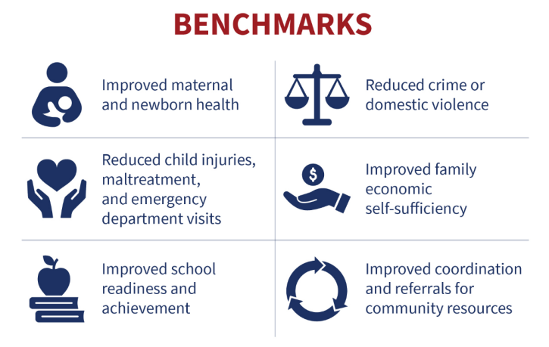
MIECHV Performance Measures are considered a leading standard in evidence-based, voluntary home visiting used for evaluating the impact of HV programs on families. These measures are part of a broader, evidence-based approach.
MIECHV Performance Measures allow programs and funders to focus on Data Driven Improvement and use the measures in commonality or shared across various funding sources with the aim to simplify, standardize, and strengthen the evaluation of program effectiveness across different grantees.
19 Performance Measures are collected across
6 Benchmark Areas:
Performance indicators: proximal (closer or near) to the home visiting intervention or more direct effects.
Systems outcome measures: distal (far or upstream) to the home visiting intervention and are long-term effects.
Notes:
MIECHV measures are our foundation or ‘core’ data collection for alignment and shared metrics to show impact.

Slide 18
MIECHV Performance Measures
1.) Preterm Birth 10.) Parent-Child Interaction
2.) Breastfeeding 11.) Early Language and Literacy Activities
3.) Depression Screening 12.) Developmental Screening
4.) Well Child Visit 13.) Behavioral Concern Inquires
5.) Postpartum Care 14.) Intimate Partner Violence Screening
6.) Tobacco Cessation Referrals 15.) Primary Caregiver Education
7.) Safe Sleep 16.) Continuity of Insurance Coverage
8.) Child Injury 17.) Completed Depression Referrals
9.) Child Maltreatment 18.) Completed Developmental Referrals
10.) Parent-Child Interaction 19.) Intimate Partner Violence Referrals
Optional Measure 1 – Substance Use Screening
Optional Measure 2 – Completed Substance Use Referrals
Notes:
I would encourage review of the MIECHV performance measures, to be familiar with the data requirements. A link to the performance measures can be found in the resource section of the RFP.

Slide 19
Application Process
Submission deadline by the end of the day on May 31, 2026. Applications submitted after the deadline will not be considered. To successfully apply, the following components must be completed and emailed to elizabeth.tietsort@oa.mo.gov before the deadline.
Completed CTF application and application certification;
Documentation verifying program’s current accreditation, registration and/or affiliation with the home visiting model of choice (i.e., model accreditation letter or certificate, letter of support, training certificates, etc.);
Detailed Program Budget for Year 1;
Applicant Agency’s Operating Budget for the current year, including income and expenses;
Provide proof of active nonprofit status (e.g., IRS determination letter) or documentation of being a qualified governmental entity;
IRS Form 990, if applicable;
Agency’s most recent financial audit summary report;
A high-level organizational chart of leadership and staff pertaining to the project; and,
Agency’s current list of Board of Directors and their affiliations.
Notes:
Complete the application as provided and provide the requested documentation as outlined. Applications are due May 31, 2026.

Slide 20
Award Notifications
Soft notifications will begin week of August 10, 2026;
Official CTF board approval will occur in September 2026;
Following board approval, awardees will be notified of official approval;
Official contract will begin September 30, 2026.
Notes:
Soft notifications will begin the week of August 10, 2026. Official CTF board approval will occur in September 2026. Following CTF board approval, the awardees will be notified with an official contract to begin on September 30, 2026. Initial contracts will have a term of one year. Grantees will have the option to renew their contracts in FY28, subject to performance and funding availability. Grantees will be eligible for up to three 1-year renewals. Award amounts are based on need and funds available, and therefore subject to change from year to year. CTF reserves the right to amend the contracts, based on ongoing work regarding home visiting payment structures.

Slide 21
Contact
Liz Tietsort
Grants Specialist
(573) 526-0674 | elizabeth.tietsort@oa.mo.gov
Amy Sielaff
Grants Supervisor - Home Visiting Program Director
(573) 526-6050 | amy.sielaff@oa.mo.gov
Notes:
The slides will be posted to our website as well as a link to the recording. A FAQ will be sent out as well in response to the questions presented during todays call.

